Slide 1

SIL Alpha CIC Model
Presented by:
Data Science (Sowndarya, Bhuvanesh)
5th August 2025

Slide 2
Architecture Overview of TDB’s Risk Scorecards
For Cash Loan only
For both Cash and SIL
Limit Setting Model (Hosted in Digital Layer)
Credit Decisioning Model (Hosted in Taran)
Beta Stack
Alpha Stack
Trench 1: New Users - within 30 days from TSA Onboarding
Limit Setting Score = Gamma Stack
Beta Demo Score
Beta Demo Score
Gamma Demo Score
Apps Score
Apps Score
Selectively call Alpha
Apps Score
Credo Score
Users automatically move from Trench 1 to Trench 2 after 30 days if no disbursed loans
Credo Score
CIC Score
Gamma Income Model
Beta Income Model
Alpha Income Model
Users will stay in Trench 2 until 1st disbursed loan. His Gamma Stack will be re-calculated every 30-day anniversary from TSA onboarding date
Limit Setting Score = Gamma Stack
Beta Stack
Alpha Stack
Gamma Demo Score
Beta Demo Score
Beta Demo Score
Trench 2: Existing Users - After 30 days from TSA Onboarding AND Never Disbursed Loan
Apps Score
Apps Score
Selectively call Alpha
Apps Score
Transaction Score
Transaction Score
Transaction Score
CIC Score
Gamma Income Model
Beta Income Model
Alpha Income Model
Users will move to Trench 3 after 1st Disbursed Loan
Lowest Risk users from this B Score will be pre-approved for upsell and xsell. Medium Risk users from this B Score will have to go through Taran.
High Risk users from this B Score will not be given any offer.
B Score = Gamma Stack
Trench 3: Existing Users - After 30 days from 1st Disbursed Loan AND current DPD <= 10
Beta Stack
Alpha Stack
Gamma Demo Score
Apps Score
Beta Demo Score
Beta Demo Score
Apps Score
Apps Score
Enhanced Transaction Score
Selectively call Alpha
Enhanced Transaction Score
Once moved to Trench 3, user will forever remain in Trench 3. His Gamma Stack will be re-calculated every 30 days anniversary from 1st Loan Disbursement Date
Enhanced Transaction Score
CIC Score
Gamma Income Model
Beta Income Model
Alpha Income Model

Slide 3
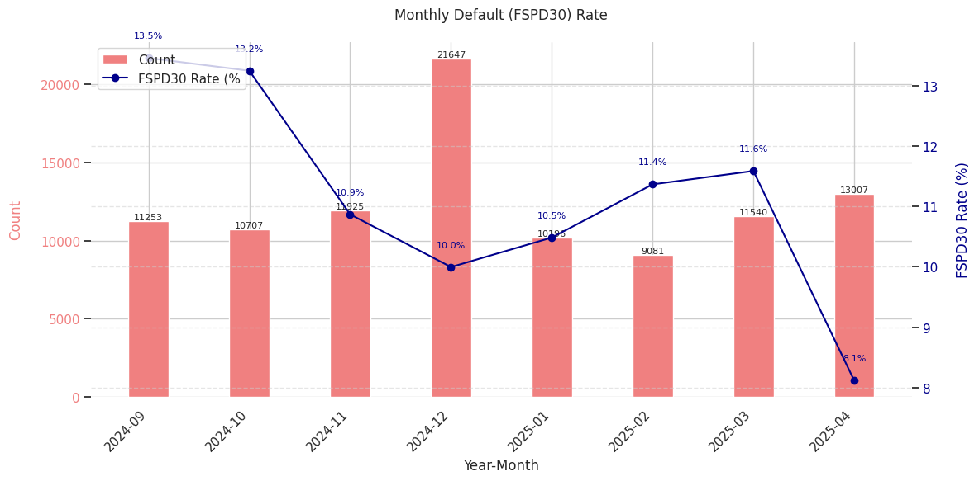
SIL Loan CIC Scorecard
 | Loan Disbursement Date | # Count | # Bad (FSPD30) Cash Loans | FSPD30 rate
Training (90%) | 01/09/2024 - 31/01/2025 | 57242 | 6540 | 11.42%
Validation (10%) | 01/09/2024 - 31/01/2025 | 6361 | 695 | 10.92%
Feb (Test) | 01/02/2025 - 28/02/2025 | 8543 | 986 | 11.54%
Mar (OOT) | 01/03/2025 - 31/03/2025 | 10965 | 1284 | 11.71%
Apr (OOT) | 01/04/2025 – 31/04/2025 | 9847 | 1033 | 10.49%
3

Slide 4
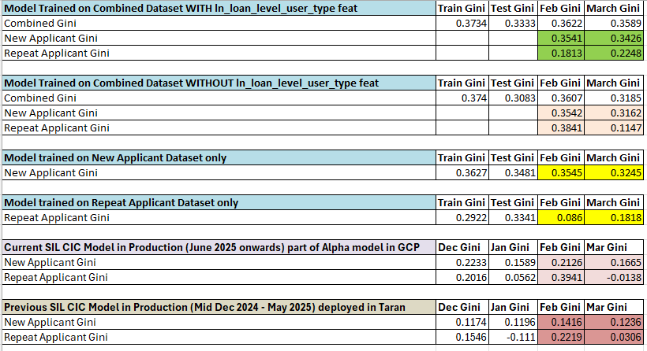
After lot of experimentations, the Model trained on combined dataset (new applicant + repeat applicant) along with the user_type feature showed the best performance and stability

Slide 5
Feature Selection Methodology Overview
Feature Selection Methodology Overview
166
Feats
112
Feats
103 Feats
60 Feats
16 Feats
Missing Rate < 95%
IV > 0.01
Inter-correlation < 75%
Individual Feature Evaluation
5

Slide 6
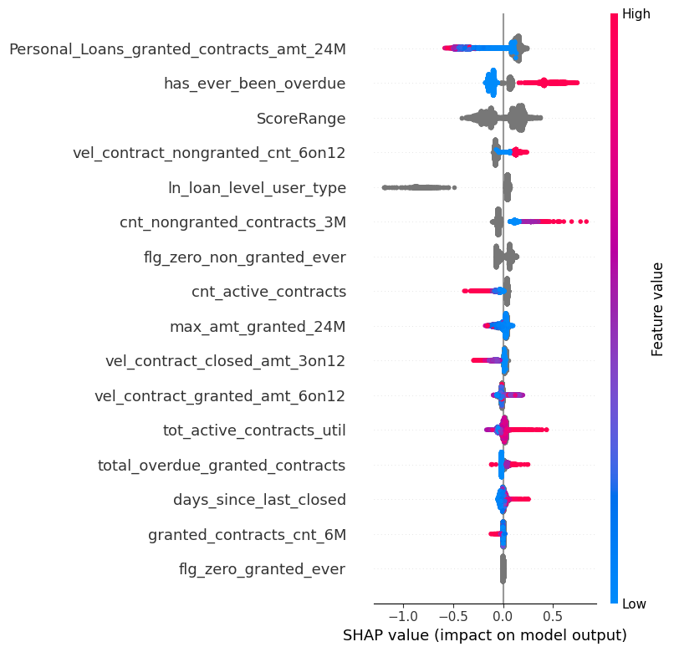
SHAP (16 feat)
The horizontal axis shows how much a feature affects the prediction. Points to the right mean the feature increases the prediction, and points to the left mean it decreases it.
The color of each dot shows the feature value: red means the value is high, and blue means the value is low. Grey means categorical feature.
If red dots are mostly on the right, it means high values of that feature increase Risk. If red dots are on the left, high values decrease Risk.
The features are listed on the vertical axis, from most important at the top to least important at the bottom.
6
Notes:
Descriptions need to be added

Slide 7
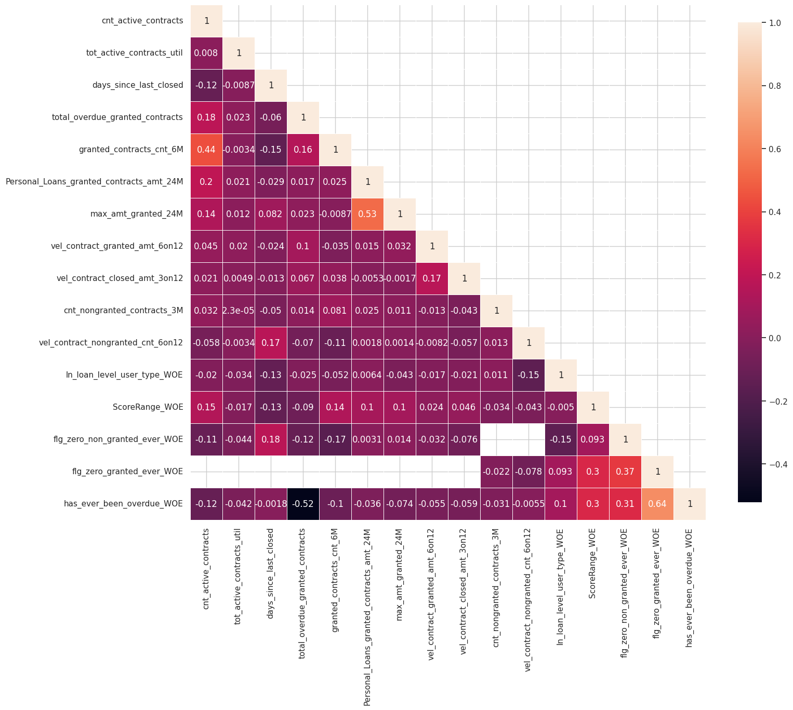
Inter-Correlation (16 feat)
The numbers show how strongly two features are related — values close to 1 mean a strong positive correlated (two features increase together), and values close to -1 mean a strong negative correlated (one feature increases while the other decreases).
Light-colored squares mean a stronger relationship, while dark ones mean weak or no relationship.
Most values here are small, so most features are not strongly related to each other — this is good for building models.
7
Notes:
Descriptions need to be added

Slide 8
Iteration |  | Train Gini | Val Gini | Feb Gini | Mar Gini | Apr Gini
5 | Personal_Loans_granted_contracts_amt_24M', 'ScoreRange', 'has_ever_been_overdue', 'ln_loan_level_user_type', 'cnt_nongranted_contracts_3M' | 0.329107 | 0.32458 | 0.344701 | 0.348038 | 0.370445
6 | flg_zero_non_granted_ever | 0.333229 | 0.320849 | 0.345969 | 0.352494 | 0.371956
7 | vel_contract_nongranted_cnt_6on12 | 0.336437 | 0.321982 | 0.343766 | 0.352276 | 0.374629
8 | cnt_active_contracts | 0.341221 | 0.326587 | 0.347074 | 0.355936 | 0.377511
9 | vel_contract_closed_amt_3on12 | 0.347203 | 0.329133 | 0.354408 | 0.354467 | 0.380379
10 | vel_contract_granted_amt_6on12 | 0.358821 | 0.333634 | 0.355766 | 0.355864 | 0.384594
11 | max_amt_granted_24M | 0.365544 | 0.335892 | 0.360381 | 0.355281 | 0.385728
12 | tot_active_contracts_util | 0.372112 | 0.338858 | 0.363691 | 0.356965 | 0.384979
13 | total_overdue_granted_contracts | 0.371378 | 0.338983 | 0.364594 | 0.359217 | 0.385367
14 | days_since_last_closed | 0.376992 | 0.339553 | 0.364341 | 0.359354 | 0.389497
15 | granted_contracts_cnt_6M | 0.377374 | 0.339289 | 0.364918 | 0.360356 | 0.388316
16 | flg_zero_granted_ever | 0.376768 | 0.3404 | 0.364611 | 0.360154 | 0.388942
16 feature model after Hyper Parameters Tuning | New + Repeat Applicant | 0.3734 | 0.3333 | 0.3622 | 0.3589 | 0.3856
 | New Applicant | 0.3596 | 0.3142 | 0.3541 | 0.3426 | 0.3751
 | Repeat Applicant | 0.3589 | 0.3054 | 0.1813 | 0.2248 | 0.1432
Hyperparameter | Value
learning_rate | 0.11982524152741872
depth | 3
l2_leaf_reg | 4.212994495196107
iterations | 1394
random_strength | 0.8385939658612559
random_seed | 42
bagging_temperature | 0.24544701677408076
border_count | 144
Hyperparameter values for the best model chosen after the HP Tuning using Optuna
8

Slide 9
SHAP Rank is overall Consistent Across Train, Test and OOT Datasets
feature | Train_Rank | Feb_Rank | Mar_Rank | Apr_Rank
Personal_Loans_granted_contracts_amt_24M | 1 | 1 | 1 | 1
ScoreRange | 2 | 3 | 3 | 3
has_ever_been_overdue | 3 | 2 | 2 | 2
cnt_nongranted_contracts_3M | 4 | 5 | 5 | 5
vel_contract_nongranted_cnt_6on12 | 5 | 6 | 6 | 6
ln_loan_level_user_type | 6 | 4 | 4 | 4
flg_zero_non_granted_ever | 7 | 7 | 7 | 7
cnt_active_contracts | 8 | 8 | 8 | 8
vel_contract_granted_amt_6on12 | 9 | 9 | 10 | 10
max_amt_granted_24M | 10 | 12 | 12 | 12
vel_contract_closed_amt_3on12 | 11 | 10 | 9 | 9
tot_active_contracts_util | 12 | 13 | 13 | 13
total_overdue_granted_contracts | 13 | 11 | 11 | 11
days_since_last_closed | 14 | 14 | 14 | 14
granted_contracts_cnt_6M | 15 | 15 | 15 | 15
flg_zero_granted_ever | 16 | 16 | 16 | 16
9

Slide 10
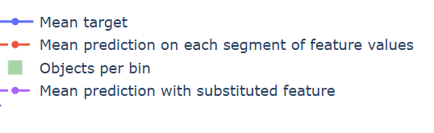
Feature Stability Plot Legend Table
 | Name | What It Shows | How to Interpret
Blue Line | Mean Target | The average true target value in each feature bin | If the line jumps around a lot, the target is unstable or noisy. If it moves smoothly, the target changes in a steady way.
Red Dashed Line | Mean Prediction | The model’s average prediction in each bin | Should generally follow the blue line. If it's a bit smoother, that means the model is generalizing well and avoiding overfitting.
Green Bars | Objects per Bin | The number of data points in each bin | Taller bars mean the signal is reliable. Very short bars mean there’s not much data, so predictions might be risky or unreliable.
Purple Dotted Line | Mean Prediction with Substituted Feature | What the model would predict if this feature was shuffled or replaced randomly | If it stays close to the red line, the model doesn’t rely much on this feature. If it's far from the red line, the model depends heavily on this feature.
10
Notes:
Descriptions need to be updated

Slide 11
Feature Evaluation Analysis (16 features)
11

Slide 12
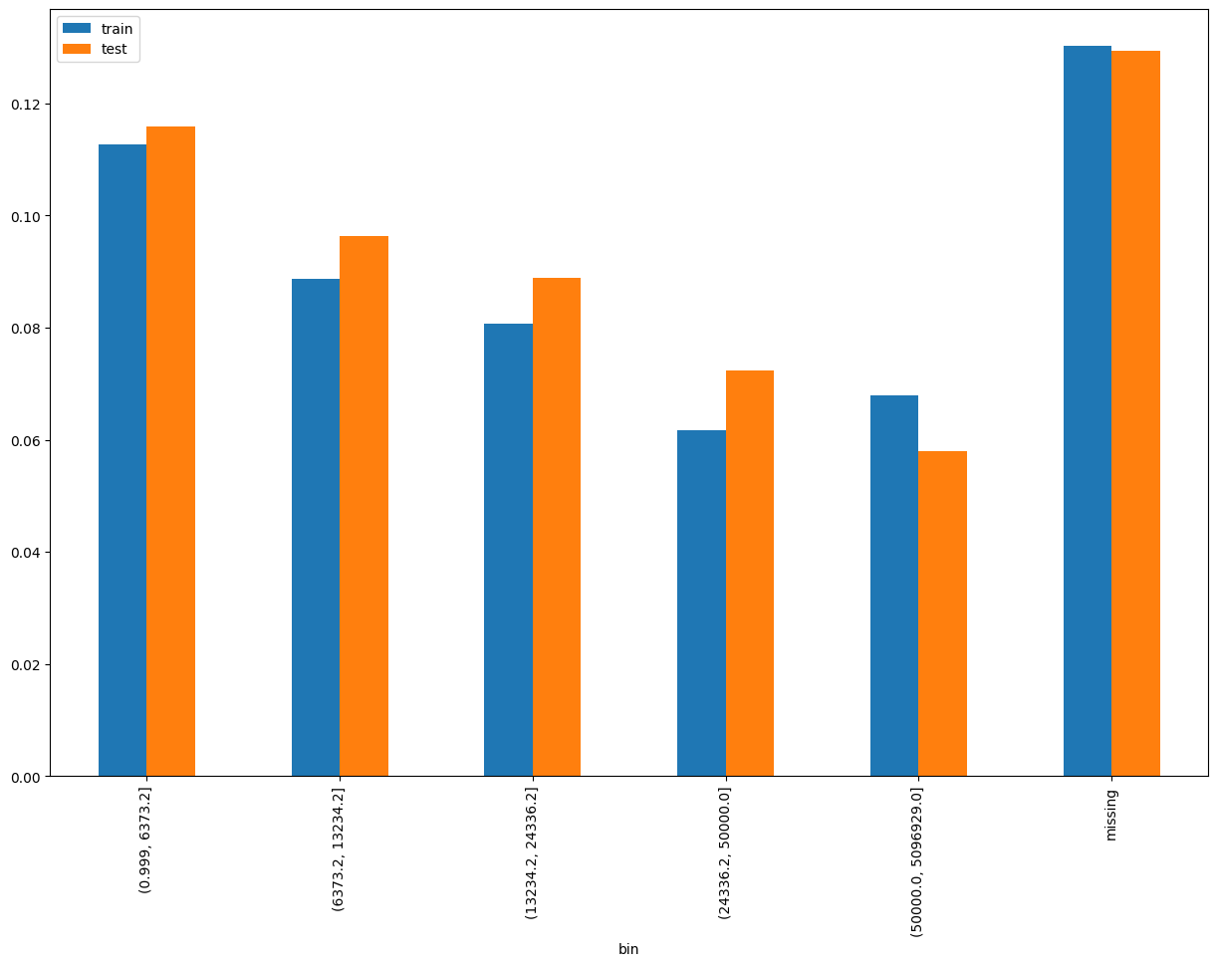
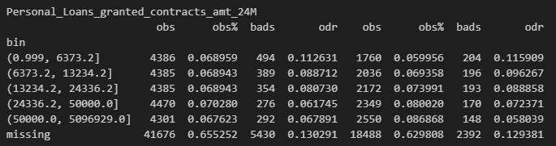
Rank# 1: Personal_Loans_granted_contracts_amt_24M (1 / 6) - Performance in Train vs Test <Disbursed>
Total amount of Personal Loans granted in the last 24 months.​
12
Please note these are just WOE Bins, NOT the final Bins that Catboost chooses internally

Slide 13
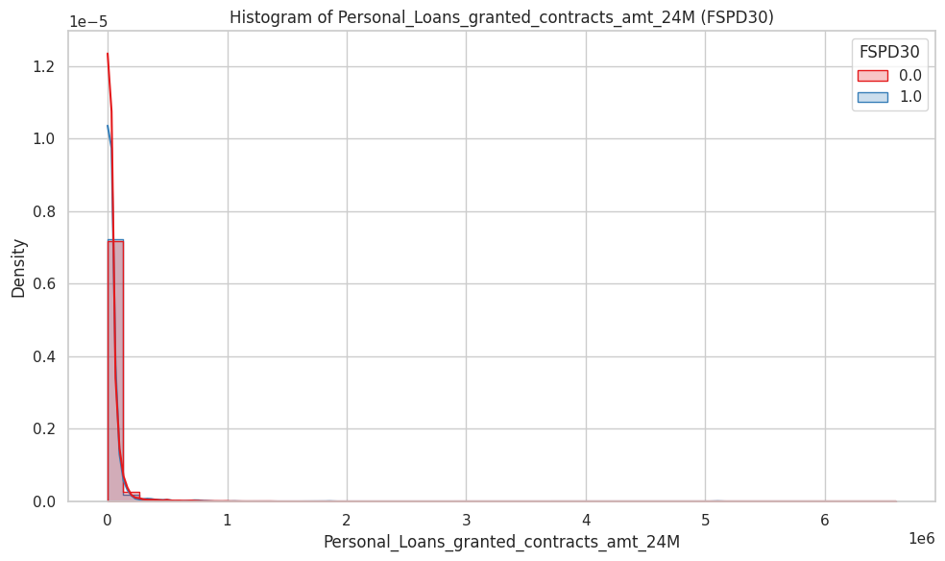
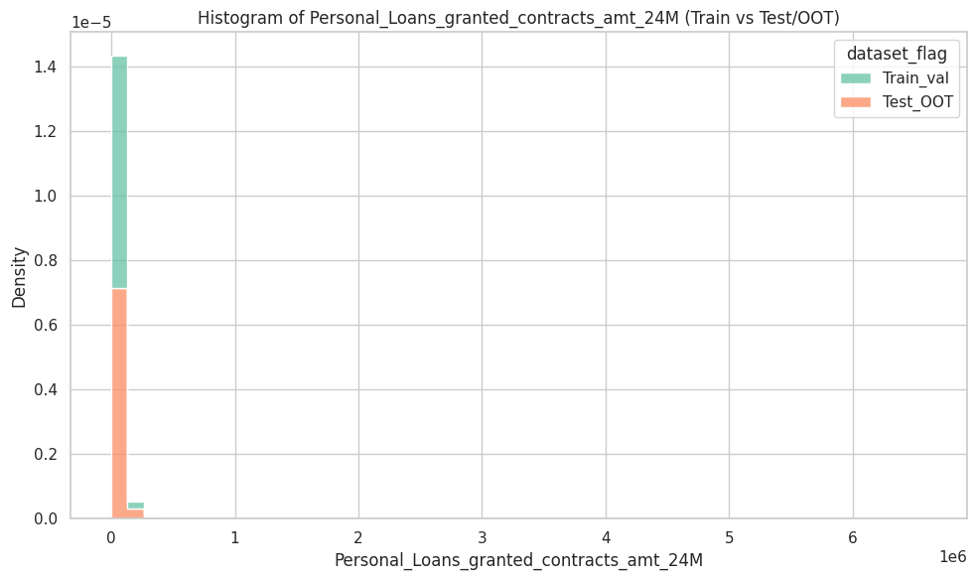
Rank# 1: Personal_Loans_granted_contracts_amt_24M (2 / 6) - Histogram <Disbursed>
Distributions are well-aligned across datasets. Most values lie below 200,000, with minimal density in the tail. No signs of drift, indicating feature stability.
Both good (red) and bad (blue) customers are heavily concentrated at low loan amounts, with a steep right-skew. Good customers show slightly higher density at very low values. Outliers above 1 million exist but are rare. Overall, distributions are very similar.
13

Slide 14

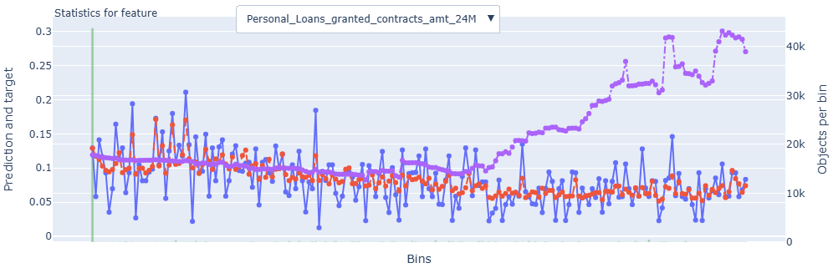
Rank# 1: Personal_Loans_granted_contracts_amt_24M (3 / 6) - Feature Statistics Analysis <Disbursed>​
The red prediction line consistently tracks the actual target (blue) across bins, showing strong alignment and model stability.
The trend is smooth with minimal volatility, indicating low noise and reliable signal from this feature.
Consistent object distribution in higher bins (purple line) supports the feature’s robustness and suitability for modeling.
14

Slide 15
Rank# 1: Personal_Loans_granted_contracts_amt_24M (4 / 6) - MoM Feature Distribution <Applied>​
Personal_Loans_granted_contracts_amt_24M | Applied Count | Approval Rate | Mean |  | Avg. CIC Score
2024-09 | 17,501 | 64.3% | 36119.2 |  | 0.1174
2024-10 | 16,814 | 63.7% | 39096.3 |  | 0.1166
2024-11 | 17,923 | 66.5% | 38046.0 |  | 0.1147
2024-12 | 33,533 | 64.5% | 35072.4 |  | 0.1154
2025-01 | 16,420 | 62.1% | 37405.4 |  | 0.1172
2025-02 | 14,246 | 63.8% | 37774.4 |  | 0.1153
2025-03 | 17,650 | 65.4% | 39732.7 |  | 0.1125
2025-04 | 19,545 | 66.6% | 41395.8 |  | 0.1102
2025-05 | 20,487 | 65.5% | 41238.5 |  | 0.1091
2025-06 | 18,006 | 67.6% | 39868.2 |  | 0.1086
2025-07 | 16,595 | 67.0% | 36269.6 |  | 0.1098
The mean loan amount trends upward from ~36K in Sep 2024 to a peak of ~41K in Apr–May 2025, followed by a gradual decline to ~36K by Jul 2025.
The progression is smooth and controlled, without any abrupt shifts or volatility in month-over-month movement.
This indicates a well-behaved and stable feature, with consistent distribution over time.
15

Slide 16
Rank# 1: Personal_Loans_granted_contracts_amt_24M (5 / 6) - MoM Feature Distribution <Applied>​
New Applicant
Personal_Loans_granted_contracts_amt_24M | Applied Count | Approval Rate | Mean |  | Avg. CIC Score
2024-09 | 16,893 | 64.0% | 35912.1 |  | 0.1200
2024-10 | 16,095 | 63.1% | 38994.2 |  | 0.1199
2024-11 | 16,954 | 65.7% | 37925.0 |  | 0.1187
2024-12 | 32,289 | 64.5% | 35048.5 |  | 0.1180
2025-01 | 15,691 | 62.3% | 36884.2 |  | 0.1205
2025-02 | 13,474 | 64.1% | 37314.7 |  | 0.1194
2025-03 | 16,626 | 65.4% | 39543.3 |  | 0.1167
2025-04 | 18,390 | 66.5% | 41268.5 |  | 0.1144
2025-05 | 19,503 | 65.5% | 41157.2 |  | 0.1124
2025-06 | 17,011 | 67.5% | 39621.7 |  | 0.1124
2025-07 | 15,811 | 66.5% | 36202.5 |  | 0.1131
Repeat Applicant
Personal_Loans_granted_contracts_amt_24M | Applied Count | Approval Rate | Mean |  | Avg. CIC Score
2024-09 | 608 | 74.2% | 42496.2 |  | 0.0444
2024-10 | 719 | 76.9% | 41705.8 |  | 0.0445
2024-11 | 969 | 81.1% | 40697.3 |  | 0.0453
2024-12 | 1,244 | 65.6% | 35825.1 |  | 0.0474
2025-01 | 729 | 58.8% | 49984.5 |  | 0.0457
2025-02 | 772 | 57.3% | 46510.7 |  | 0.0443
2025-03 | 1,024 | 64.1% | 42835.5 |  | 0.0442
2025-04 | 1,155 | 67.8% | 43493.2 |  | 0.0438
2025-05 | 984 | 65.3% | 43112.0 |  | 0.0443
2025-06 | 995 | 69.8% | 44236.3 |  | 0.0434
2025-07 | 784 | 76.7% | 37676.1 |  | 0.0426
The New Applicant segment shows a consistent increase in mean loan amount from ~35.9K to ~41.3K by Apr–May 2025, tapering slightly to ~36.2K by Jul.
The distribution evolves gradually, with stable transitions across months and no sharp deviations.
This behavior reinforces the feature’s reliability for modeling within the new applicant population.
The Repeat Applicant segment consistently shows higher mean values, peaking at ~50K in Jan 2025, and stabilizing around ~43–44K in the following months.
The shift over time is smooth and predictable, despite smaller sample sizes.
The clear trend and lack of irregularity confirm strong distributional stability for repeat users.
16

Slide 17
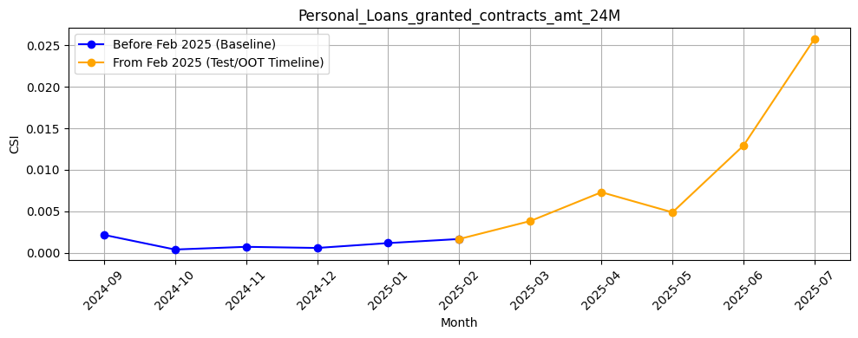
Rank# 1: Personal_Loans_granted_contracts_amt_24M (6 / 6) - Feature CSI Analysis <Applied>​
Baseline period: Sep’2024 to Jan’2025.
CSI for Personal_Loans_granted_contracts_amt_24M was minimal and stable during training, ranging from ~0.00 to ~0.002. In the Test/OOT period (Feb to Jul 2025), CSI values steadily increased, rising from ~0.002 in Feb to ~0.026 in Jul 2025. Despite remaining below the 0.1 threshold, the gradual upward trend may indicate early signs of drift, warranting monitoring.
17

Slide 18
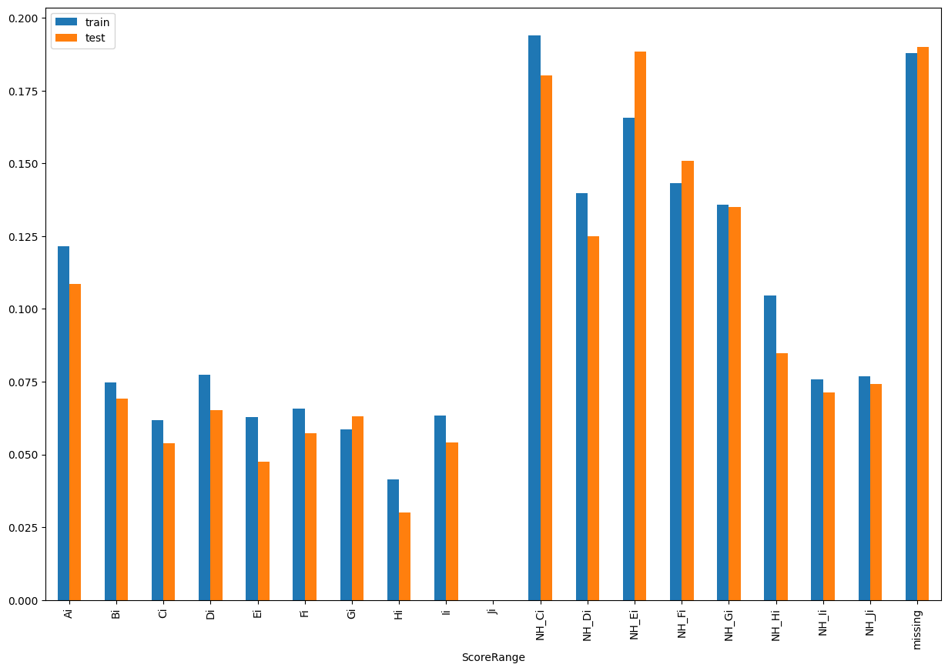
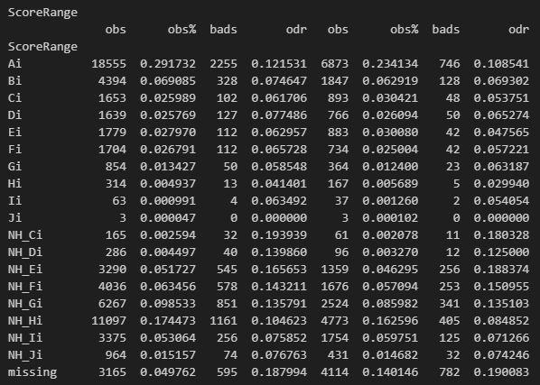
Rank# 2: ScoreRange (1 / 5) - Performance in Train vs Test <Disbursed>
This feature is indicative of the overall risk score segment of the user from CRIF.
18
Please note these are just WOE Bins, NOT the final Bins that Catboost chooses internally

Slide 19
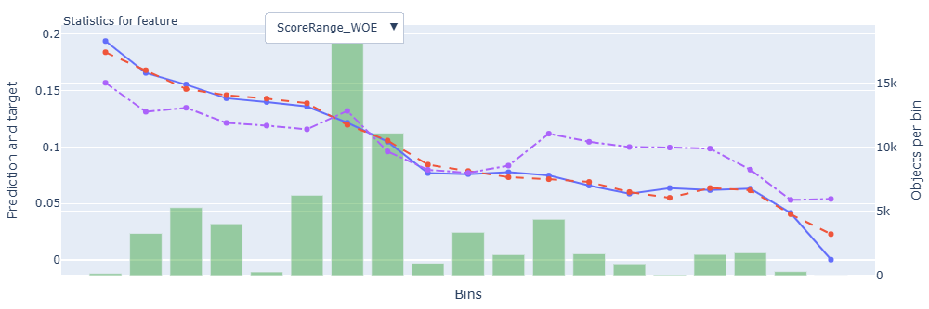
Rank# 2: ScoreRange (2 / 5) - Feature Statistics Analysis <Disbursed>​
The red line (model prediction) generally aligns with the blue line (actual outcome), suggesting the model understands this feature’s overall trend.
A small separation between the red and purple lines shows this feature contributes to refining predictions.
19

Slide 20
Rank# 2: ScoreRange (3 / 5) - MoM Feature Distribution <Applied>​
ScoreRange | Applied Count | Approval Rate | Ai | NH_Hi | missing | NH_Gi | NH_Fi | NH_Ei | Bi | NH_Ii | Ei | Ci | Di | Fi | NH_Ji | Gi | NH_Di | Hi | NH_Ci | Ii | Ji |  | Avg. CIC Score
2024-09 | 17,501 | 64.3% | 22.2% | 15.4% | 19.1% | 10.1% | 7.1% | 7.2% | 3.9% | 4.1% | 2.0% | 1.8% | 1.8% | 1.8% | 1.4% | 0.9% | 0.5% | 0.3% | 0.3% | 0.1% | 0.0% |  | 0.1174
2024-10 | 16,814 | 63.7% | 24.1% | 15.1% | 18.2% | 9.3% | 6.5% | 7.0% | 4.5% | 4.5% | 1.9% | 1.9% | 2.1% | 1.7% | 1.1% | 0.8% | 0.5% | 0.4% | 0.4% | 0.1% | 0.0% |  | 0.1166
2024-11 | 17,923 | 66.5% | 25.5% | 15.3% | 16.9% | 9.1% | 5.9% | 6.3% | 5.5% | 4.5% | 2.1% | 2.0% | 1.8% | 1.9% | 1.3% | 0.9% | 0.5% | 0.4% | 0.3% | 0.1% | 0.0% |  | 0.1147
2024-12 | 33,533 | 64.5% | 28.7% | 15.8% | 10.5% | 9.6% | 6.5% | 6.3% | 6.3% | 4.7% | 2.1% | 2.0% | 2.0% | 2.0% | 1.3% | 0.9% | 0.4% | 0.3% | 0.3% | 0.1% | 0.0% |  | 0.1154
2025-01 | 16,420 | 62.1% | 25.9% | 15.4% | 15.3% | 9.7% | 6.5% | 5.5% | 5.5% | 4.9% | 1.9% | 2.0% | 1.8% | 2.1% | 1.3% | 1.2% | 0.4% | 0.4% | 0.2% | 0.1% | 0.0% |  | 0.1172
2025-02 | 14,246 | 63.8% | 23.4% | 14.4% | 19.1% | 9.0% | 6.2% | 5.8% | 5.0% | 5.0% | 2.5% | 2.0% | 2.0% | 2.1% | 1.5% | 0.9% | 0.4% | 0.4% | 0.3% | 0.1% | 0.0% |  | 0.1153
2025-03 | 17,650 | 65.4% | 22.9% | 15.4% | 17.8% | 9.1% | 6.3% | 5.9% | 5.1% | 5.5% | 2.4% | 2.4% | 1.9% | 2.1% | 1.2% | 1.1% | 0.4% | 0.4% | 0.2% | 0.1% | 0.0% |  | 0.1125
2025-04 | 19,545 | 66.6% | 22.2% | 16.2% | 15.6% | 9.5% | 6.7% | 6.1% | 5.4% | 5.4% | 2.5% | 2.7% | 2.4% | 2.0% | 1.2% | 0.8% | 0.4% | 0.4% | 0.3% | 0.1% | 0.0% |  | 0.1102
2025-05 | 20,487 | 65.5% | 21.8% | 16.8% | 14.9% | 9.8% | 7.0% | 6.1% | 5.6% | 5.8% | 2.4% | 2.4% | 2.3% | 1.9% | 1.3% | 0.9% | 0.4% | 0.4% | 0.2% | 0.1% | 0.0% |  | 0.1091
2025-06 | 18,006 | 67.6% | 21.6% | 16.8% | 15.6% | 9.6% | 6.1% | 6.4% | 5.2% | 5.6% | 2.6% | 2.6% | 2.6% | 2.0% | 1.3% | 0.9% | 0.5% | 0.3% | 0.3% | 0.1% | 0.0% |  | 0.1086
2025-07 | 16,595 | 67.0% | 25.0% | 15.9% | 12.3% | 9.6% | 6.0% | 6.3% | 6.1% | 5.8% | 2.7% | 2.8% | 2.4% | 2.2% | 1.0% | 1.0% | 0.3% | 0.4% | 0.3% | 0.1% | 0.0% |  | 0.1098
The high-score segment (Ai) gradually increases from ~22% in Sep 2024 to a peak of 28.7% in Dec, then stabilizes around 21–25% through Jul 2025, reflecting controlled shifts.
Mid-tier buckets like NH_Hi, NH_Gi, NH_Fi, Bi, and NH_Ii show smooth and steady proportions across months, reinforcing distributional consistency.
Low-score ranges remain minimal and stable, with no sharp changes observed. Overall, the feature exhibits strong MoM stability across score bands.
20

Slide 21
Rank# 2: ScoreRange (4 / 5) - MoM Feature Distribution <Applied> <User Type wise> ​
New Applicant
ScoreRange | Applied Count | Approval Rate | Ai | NH_Hi | missing | NH_Gi | NH_Fi | NH_Ei | Bi | NH_Ii | Ei | Ci | Di | Fi | NH_Ji | Gi | NH_Di | Hi | NH_Ci | Ii | Ji |  | Avg. CIC Score
2024-09 | 16,893 | 64.0% | 20.9% | 15.7% | 19.5% | 10.3% | 7.2% | 7.4% | 4.0% | 4.2% | 2.0% | 1.7% | 1.7% | 1.8% | 1.4% | 0.9% | 0.5% | 0.3% | 0.3% | 0.1% | 0.0% |  | 0.1200
2024-10 | 16,095 | 63.1% | 22.4% | 15.4% | 18.7% | 9.6% | 6.7% | 7.3% | 4.5% | 4.6% | 1.9% | 1.9% | 2.1% | 1.7% | 1.1% | 0.8% | 0.5% | 0.4% | 0.4% | 0.1% | 0.0% |  | 0.1199
2024-11 | 16,954 | 65.7% | 23.3% | 15.8% | 17.5% | 9.4% | 6.1% | 6.5% | 5.5% | 4.7% | 2.1% | 2.0% | 1.8% | 1.9% | 1.3% | 0.9% | 0.5% | 0.4% | 0.3% | 0.1% | 0.0% |  | 0.1187
2024-12 | 32,289 | 64.5% | 27.3% | 16.2% | 10.7% | 9.9% | 6.6% | 6.5% | 6.3% | 4.9% | 2.1% | 2.0% | 2.0% | 2.0% | 1.3% | 1.0% | 0.4% | 0.3% | 0.4% | 0.1% | 0.0% |  | 0.1180
2025-01 | 15,691 | 62.3% | 24.3% | 15.8% | 15.8% | 9.9% | 6.7% | 5.7% | 5.5% | 5.1% | 1.9% | 2.0% | 1.7% | 2.1% | 1.3% | 1.2% | 0.4% | 0.4% | 0.2% | 0.1% | 0.0% |  | 0.1205
2025-02 | 13,474 | 64.1% | 21.4% | 14.9% | 19.8% | 9.4% | 6.4% | 6.1% | 5.0% | 5.2% | 2.5% | 2.0% | 1.9% | 2.1% | 1.6% | 0.9% | 0.4% | 0.4% | 0.3% | 0.1% | 0.0% |  | 0.1194
2025-03 | 16,626 | 65.4% | 20.8% | 16.0% | 18.5% | 9.4% | 6.5% | 6.2% | 5.1% | 5.6% | 2.4% | 2.3% | 1.9% | 2.1% | 1.2% | 1.1% | 0.4% | 0.4% | 0.2% | 0.1% | 0.0% |  | 0.1167
2025-04 | 18,390 | 66.5% | 20.4% | 16.7% | 16.1% | 9.8% | 6.9% | 6.3% | 5.4% | 5.6% | 2.5% | 2.7% | 2.3% | 2.0% | 1.3% | 0.9% | 0.4% | 0.4% | 0.3% | 0.1% | 0.0% |  | 0.1144
2025-05 | 19,503 | 65.5% | 20.6% | 17.1% | 15.3% | 10.0% | 7.2% | 6.2% | 5.6% | 5.9% | 2.3% | 2.3% | 2.3% | 1.9% | 1.3% | 1.0% | 0.4% | 0.4% | 0.3% | 0.1% | 0.0% |  | 0.1124
2025-06 | 17,011 | 67.5% | 20.4% | 17.0% | 16.0% | 9.8% | 6.3% | 6.5% | 5.1% | 5.7% | 2.6% | 2.6% | 2.6% | 2.0% | 1.4% | 0.9% | 0.5% | 0.3% | 0.3% | 0.1% | 0.0% |  | 0.1124
2025-07 | 15,811 | 66.5% | 24.6% | 16.0% | 12.5% | 9.7% | 6.0% | 6.4% | 5.9% | 5.8% | 2.6% | 2.8% | 2.4% | 2.2% | 1.0% | 1.0% | 0.3% | 0.3% | 0.3% | 0.1% | 0.0% |  | 0.1131
Repeat Applicant
ScoreRange | Applied Count | Approval Rate | Ai | NH_Hi | missing | Bi | NH_Gi | NH_Fi | Ci | NH_Ii | Di | Ei | NH_Ei | Fi | Gi | NH_Ji | Hi | NH_Di | Ii | NH_Ci | missing |  | Avg. CIC Score
2024-09 | 608 | 74.2% | 60.2% | 7.2% | 7.2% | 2.6% | 4.3% | 3.1% | 3.0% | 1.8% | 3.0% | 2.1% | 2.1% | 1.6% | 0.2% | 1.2% | 0.2% | 0.2% | 0.0% | 0.0% | 0.0% |  | 0.0444
2024-10 | 719 | 76.9% | 62.2% | 6.5% | 6.8% | 3.6% | 3.3% | 2.6% | 1.9% | 1.9% | 2.1% | 3.9% | 2.1% | 1.8% | 0.7% | 0.3% | 0.1% | 0.0% | 0.0% | 0.0% | 0.0% |  | 0.0445
2024-11 | 969 | 81.1% | 62.5% | 6.9% | 5.4% | 5.0% | 4.0% | 2.7% | 2.1% | 1.4% | 2.1% | 2.2% | 1.9% | 1.7% | 0.8% | 0.3% | 0.6% | 0.3% | 0.2% | 0.0% | 0.0% |  | 0.0453
2024-12 | 1,244 | 65.6% | 65.2% | 7.0% | 3.4% | 4.7% | 2.1% | 2.7% | 2.2% | 1.6% | 2.7% | 2.3% | 2.3% | 2.2% | 0.6% | 0.4% | 0.4% | 0.2% | 0.0% | 0.0% | 0.0% |  | 0.0474
2025-01 | 729 | 58.8% | 60.2% | 5.6% | 5.2% | 5.3% | 4.1% | 3.2% | 2.5% | 1.8% | 2.9% | 1.6% | 1.8% | 2.5% | 1.0% | 1.1% | 0.5% | 0.4% | 0.1% | 0.1% | 0.0% |  | 0.0457
2025-02 | 772 | 57.3% | 58.7% | 5.7% | 7.3% | 5.7% | 3.0% | 3.0% | 2.3% | 2.3% | 3.5% | 2.2% | 1.0% | 2.3% | 1.2% | 0.8% | 0.5% | 0.3% | 0.1% | 0.1% | 0.0% |  | 0.0443
2025-03 | 1,024 | 64.1% | 55.5% | 6.6% | 7.3% | 6.2% | 4.4% | 2.3% | 3.9% | 2.4% | 2.5% | 2.1% | 2.0% | 1.7% | 1.4% | 0.6% | 0.5% | 0.6% | 0.0% | 0.0% | 0.0% |  | 0.0442
2025-04 | 1,155 | 67.8% | 49.9% | 9.0% | 7.7% | 5.5% | 5.2% | 3.5% | 3.4% | 3.3% | 2.9% | 2.7% | 2.9% | 1.7% | 0.6% | 0.9% | 0.3% | 0.3% | 0.2% | 0.0% | 0.0% |  | 0.0438
2025-05 | 984 | 65.3% | 45.9% | 11.1% | 7.3% | 5.8% | 5.9% | 3.8% | 3.5% | 4.4% | 2.6% | 2.7% | 3.4% | 1.6% | 0.8% | 0.8% | 0.0% | 0.1% | 0.2% | 0.1% | 0.0% |  | 0.0443
2025-06 | 995 | 69.8% | 42.0% | 12.2% | 7.9% | 7.3% | 6.1% | 3.3% | 2.7% | 3.7% | 2.4% | 3.2% | 4.1% | 1.7% | 0.9% | 1.1% | 0.2% | 0.6% | 0.0% | 0.4% | 0.0% |  | 0.0434
2025-07 | 784 | 76.7% | 33.3% | 12.5% | 8.9% | 9.3% | 7.0% | 4.8% | 3.6% | 5.6% | 3.2% | 3.3% | 3.7% | 1.8% | 0.6% | 1.1% | 0.8% | 0.3% | 0.0% | 0.1% | 0.0% |  | 0.0426
21

Slide 22
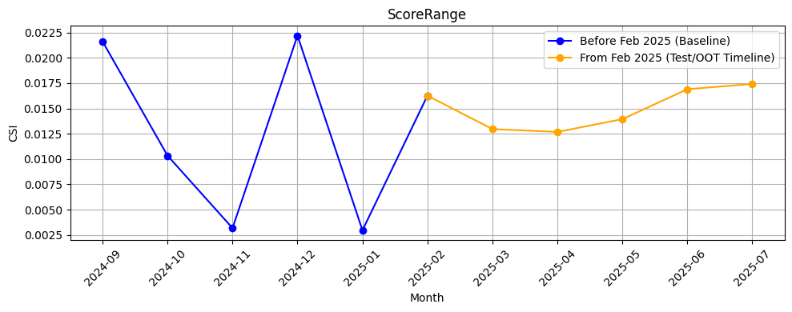
Rank# 2: ScoreRange (5 / 5) - Feature CSI Analysis <Applied>​
Baseline period: Sep’2024 to Jan’2025.
CSI for ScoreRange showed moderate oscillations during the training period, fluctuating between ~0.003 to ~0.022. In the Test/OOT period (Feb to Jul 2025), CSI remained steady in the ~0.013 to ~0.018 range, consistently below the 0.1 threshold. This indicates stable feature distribution with no signs of data drift.

Slide 23
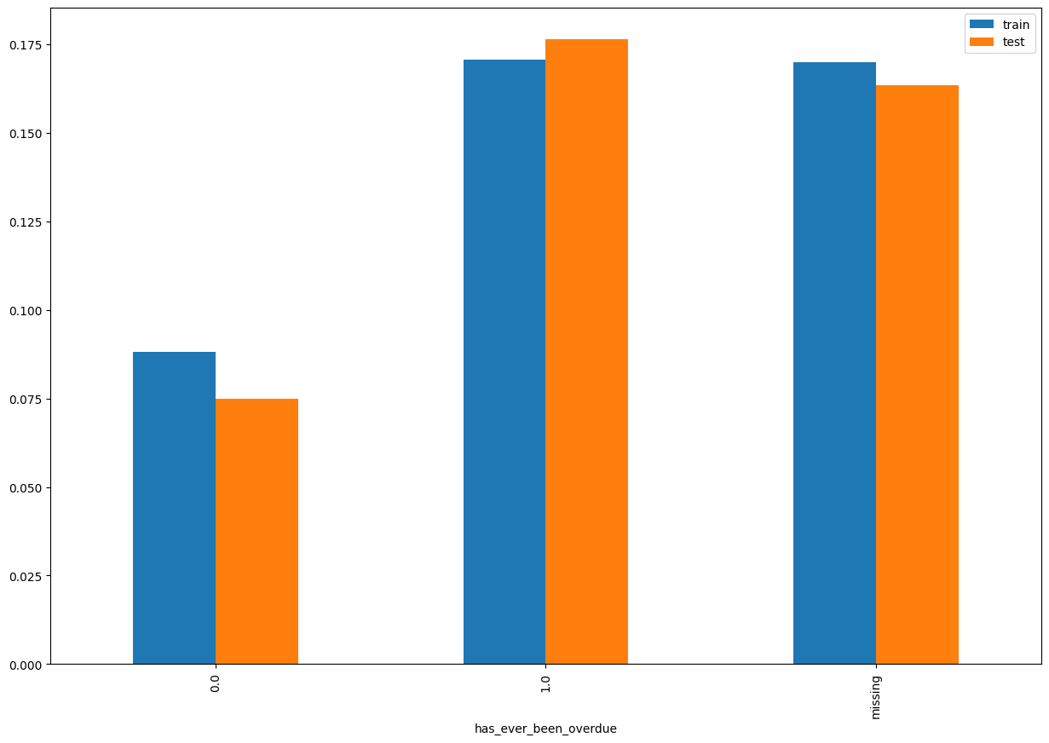
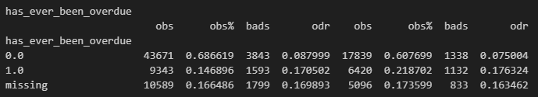
Rank# 3: has_ever_been_overdue (1 / 5) - Performance in Train vs Test <Disbursed>
1 if the account has ever had an overdue contract, otherwise 0.
23
Please note these are just WOE Bins, NOT the final Bins that Catboost chooses internally

Slide 24
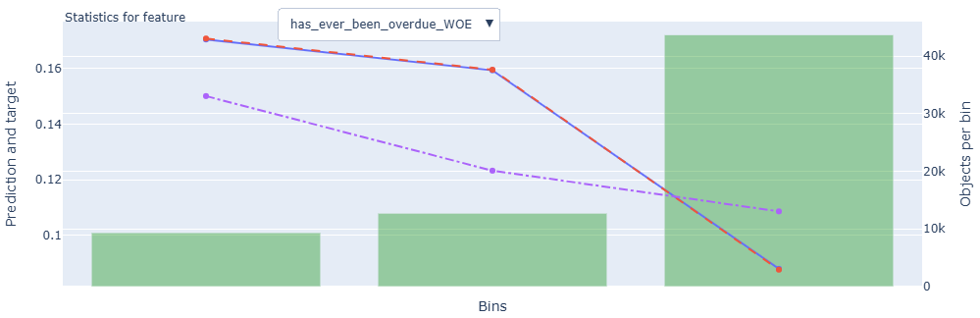
Rank# 3: has_ever_been_overdue (2 / 5) - Feature Statistics Analysis <Disbursed>​
The red line closely tracks the blue line across all bins, showing consistency in predicted probabilities.
There's a distinct gap between the red and purple lines, especially in the middle bins.
This indicates strong predictive power and good feature separation.
24

Slide 25
Rank# 3: has_ever_been_overdue (3 / 5) - MoM Feature Distribution <Applied>​
has_ever_been_overdue | Applied Count | Approval Rate | 0 | missing | 1 |  | Avg. CIC Score
2024-09 | 17,501 | 64.3% | 51.1% | 26.2% | 22.8% |  | 0.1174
2024-10 | 16,814 | 63.7% | 51.5% | 24.7% | 23.8% |  | 0.1166
2024-11 | 17,923 | 66.5% | 53.3% | 22.9% | 23.8% |  | 0.1147
2024-12 | 33,533 | 64.5% | 54.0% | 23.4% | 22.5% |  | 0.1154
2025-01 | 16,420 | 62.1% | 50.7% | 28.3% | 21.0% |  | 0.1172
2025-02 | 14,246 | 63.8% | 52.2% | 27.0% | 20.8% |  | 0.1153
2025-03 | 17,650 | 65.4% | 52.7% | 26.2% | 21.0% |  | 0.1125
2025-04 | 19,545 | 66.6% | 54.7% | 23.0% | 22.3% |  | 0.1102
2025-05 | 20,487 | 65.5% | 55.3% | 22.4% | 22.3% |  | 0.1091
2025-06 | 18,006 | 67.6% | 55.0% | 22.5% | 22.5% |  | 0.1086
2025-07 | 16,595 | 67.0% | 55.2% | 21.0% | 23.8% |  | 0.1098
The share of users with no overdue history (bucket "0") increases steadily from ~51% to ~55% between Sep 2024 and Jul 2025, indicating a gradual shift toward cleaner credit behavior.
The “missing” bucket shows a soft downward trend from ~26% to ~21%, while the “1” bucket remains stable around 21–24% without abrupt jumps.
Overall, the distribution moves progressively over time and stays well within a stable range, reinforcing its reliability for modeling.
25

Slide 26
Rank# 3: has_ever_been_overdue (4 / 5) - MoM Feature Distribution <Applied> <User Type wise> ​
New Applicant
has_ever_been_overdue | Applied Count | Approval Rate | 0 | missing | 1 |  | Avg. CIC Score
2024-09 | 16,893 | 64.0% | 50.0% | 26.9% | 23.1% |  | 0.1200
2024-10 | 16,095 | 63.1% | 50.2% | 25.5% | 24.3% |  | 0.1199
2024-11 | 16,954 | 65.7% | 51.6% | 24.0% | 24.5% |  | 0.1187
2024-12 | 32,289 | 64.5% | 52.9% | 24.2% | 22.9% |  | 0.1180
2025-01 | 15,691 | 62.3% | 49.3% | 29.3% | 21.4% |  | 0.1205
2025-02 | 13,474 | 64.1% | 50.3% | 28.3% | 21.4% |  | 0.1194
2025-03 | 16,626 | 65.4% | 50.9% | 27.6% | 21.5% |  | 0.1167
2025-04 | 18,390 | 66.5% | 53.1% | 24.1% | 22.8% |  | 0.1144
2025-05 | 19,503 | 65.5% | 54.1% | 23.2% | 22.7% |  | 0.1124
2025-06 | 17,011 | 67.5% | 53.9% | 23.4% | 22.7% |  | 0.1124
2025-07 | 15,811 | 66.5% | 54.3% | 21.6% | 24.1% |  | 0.1131
Repeat Applicant
has_ever_been_overdue | Applied Count | Approval Rate | 0 | 1 | missing |  | Avg. CIC Score
2024-09 | 608 | 74.2% | 80.9% | 12.5% | 6.6% |  | 0.0444
2024-10 | 719 | 76.9% | 81.4% | 12.5% | 6.1% |  | 0.0445
2024-11 | 969 | 81.1% | 83.8% | 11.2% | 5.0% |  | 0.0453
2024-12 | 1,244 | 65.6% | 82.1% | 13.5% | 4.4% |  | 0.0474
2025-01 | 729 | 58.8% | 80.9% | 12.3% | 6.7% |  | 0.0457
2025-02 | 772 | 57.3% | 84.6% | 11.1% | 4.3% |  | 0.0443
2025-03 | 1,024 | 64.1% | 82.6% | 12.9% | 4.5% |  | 0.0442
2025-04 | 1,155 | 67.8% | 81.2% | 13.9% | 4.9% |  | 0.0438
2025-05 | 984 | 65.3% | 78.7% | 14.5% | 6.8% |  | 0.0443
2025-06 | 995 | 69.8% | 74.6% | 17.6% | 7.8% |  | 0.0434
2025-07 | 784 | 76.7% | 71.9% | 18.6% | 9.4% |  | 0.0426
New applicants show a consistent rise in the clean segment ("0") from ~50% to ~54%, reflecting improving credit behavior across this group.
The "missing" bucket declines from ~27% to ~21%, while the overdue segment ("1") fluctuates mildly around 21–24% with no sharp spikes.
The overall distribution remains balanced and shows smooth evolution, suggesting strong modeling suitability for this segment.
The clean segment ("0") dominates, staying above ~71% throughout and peaking at ~84% in early 2025, before gradually declining to ~72% in Jul.
The overdue group ("1") rises from ~11–13% to ~18.6% toward Jul, showing a slow and steady upward trend, with “missing” remaining minimal.
Distribution changes are progressive and stable, confirming the feature’s consistency and strong segmentation value for repeat users.
26

Slide 27
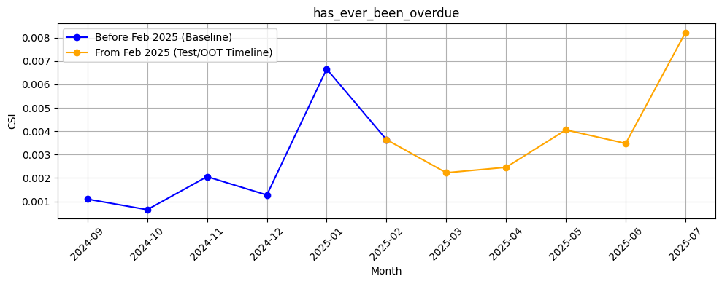
Rank# 3: has_ever_been_overdue (5 / 5) - Feature CSI Analysis <Applied>​
Baseline period: Sep’2024 to Jan’2025.
CSI for has_ever_been_overdue remained low and stable during training, ranging from ~0.001 to ~0.007. During the Test/OOT period (Feb to Jul 2025), CSI values ranged from ~0.002 to ~0.008, showing a slight upward trend but still well below the 0.1 threshold. No data drift detected, but continued observation is recommended.
27

Slide 28
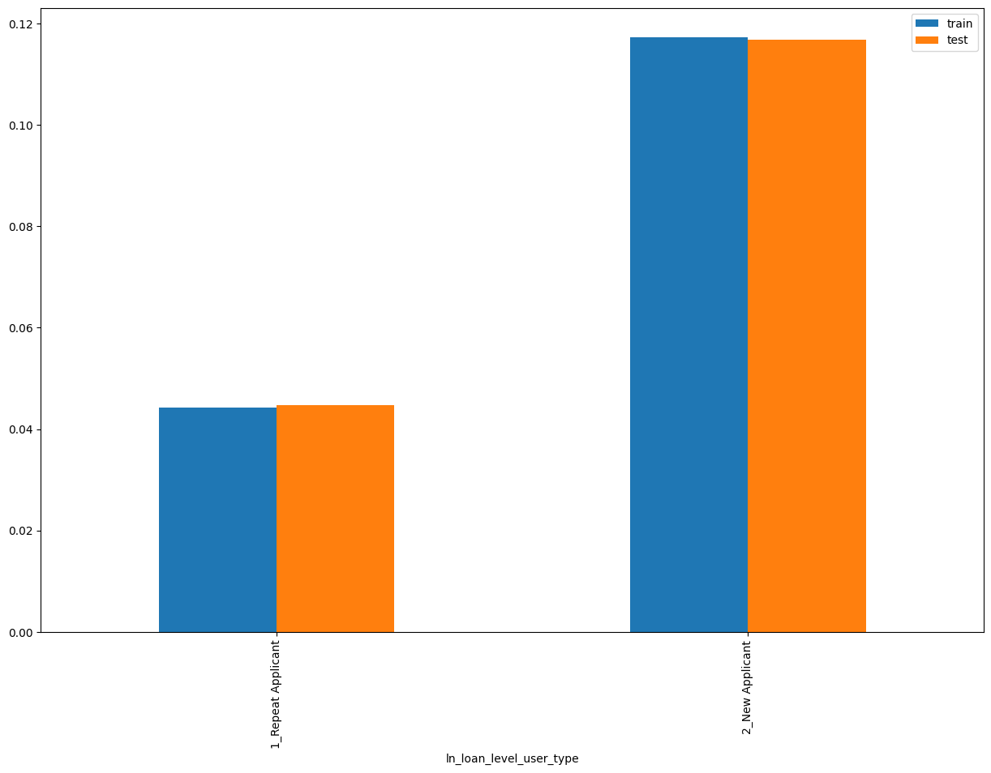
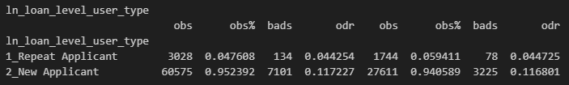
Rank# 4: ln_loan_level_user_type (1 / 4) - Performance in Train vs Test <Disbursed>
Loan level user type “New Applicant” or “Repeat Applicant”
28
Please note these are just WOE Bins, NOT the final Bins that Catboost chooses internally

Slide 29
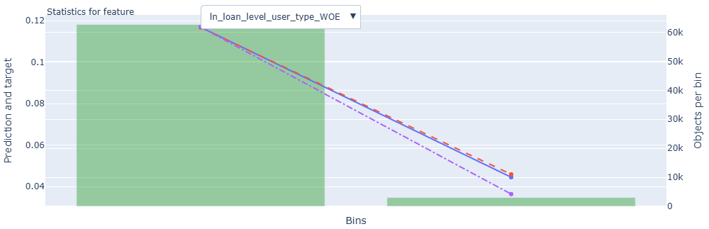
Rank# 4: ln_loan_level_user_type (2 / 4) - Feature Statistics Analysis <Disbursed>​
The red and blue lines overlap closely, indicating that the model is accurately capturing the relationship between this feature and default behavior.
The gap between the red and purple lines (small but visible) suggests that ln_loan_level_user_type adds predictive value — the model performs better with it included.
29

Slide 30
Rank# 4: ln_loan_level_user_type (3 / 4) - MoM Feature Distribution <Applied>​
ln_loan_level_user_type | Applied Count | Approval Rate | 2_New Applicant | 1_Repeat Applicant |  | Avg. CIC Score
2024-09 | 17,501 | 64.3% | 96.5% | 3.5% |  | 0.1174
2024-10 | 16,814 | 63.7% | 95.7% | 4.3% |  | 0.1166
2024-11 | 17,923 | 66.5% | 94.6% | 5.4% |  | 0.1147
2024-12 | 33,533 | 64.5% | 96.3% | 3.7% |  | 0.1154
2025-01 | 16,420 | 62.1% | 95.6% | 4.4% |  | 0.1172
2025-02 | 14,246 | 63.8% | 94.6% | 5.4% |  | 0.1153
2025-03 | 17,650 | 65.4% | 94.2% | 5.8% |  | 0.1125
2025-04 | 19,545 | 66.6% | 94.1% | 5.9% |  | 0.1102
2025-05 | 20,487 | 65.5% | 95.2% | 4.8% |  | 0.1091
2025-06 | 18,006 | 67.6% | 94.5% | 5.5% |  | 0.1086
2025-07 | 16,595 | 67.0% | 95.3% | 4.7% |  | 0.1098
The New Applicant segment remains the dominant share, consistently contributing ~94–96% month-over-month, with only minor fluctuations observed.
The Repeat Applicant share increases gradually from 3.5% in Sep 2024 to 5.9% by Apr 2025, then slightly recedes to 4.7% in Jul 2025.
Changes across both segments are smooth and progressive, reflecting a stable distribution trend ideal for modeling applications.

Slide 31
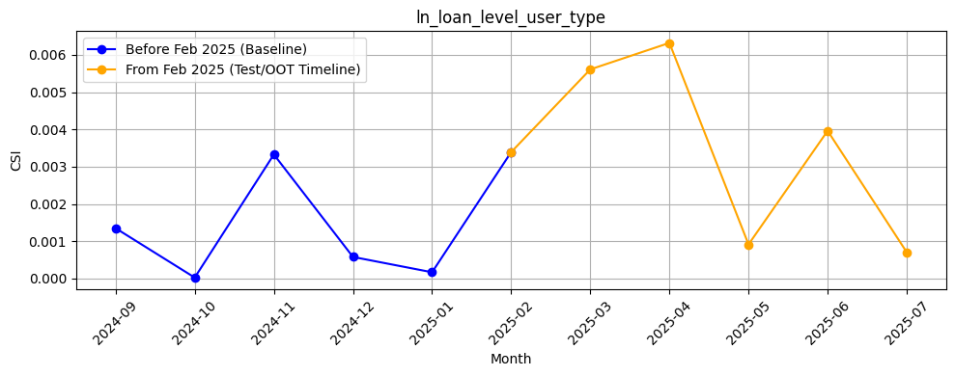
Rank# 4: ln_loan_level_user_type (4 / 4) - Feature CSI Analysis <Applied>​
Baseline period: Sep’2024 to Jan’2025.
CSI for in_loan_level_user_type remained extremely low during the training period, ranging from ~0.00 to ~0.003. In the Test/OOT period (Feb to Jul 2025), CSI values fluctuated between ~0.001 and ~0.006, showing excellent feature stability and no indication of data drift.

Slide 32
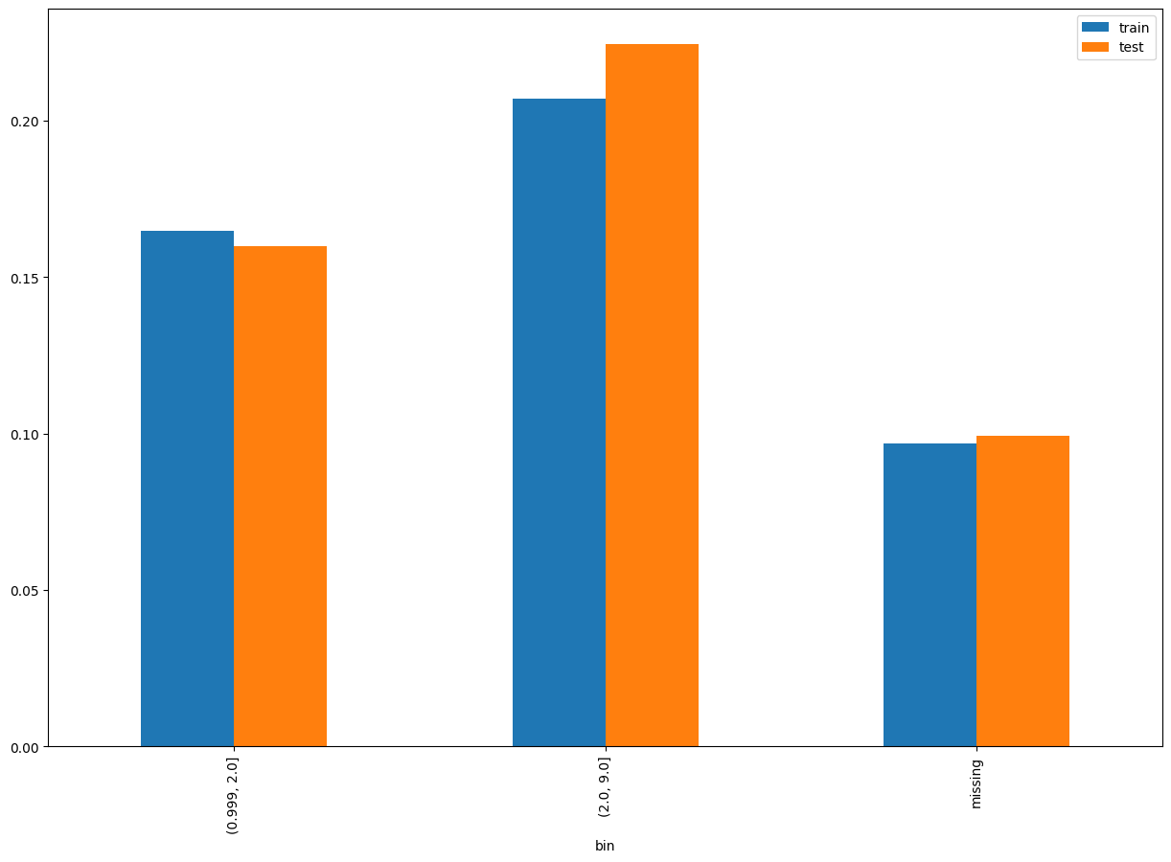
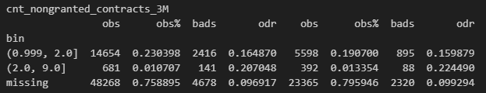
Rank# 5: cnt_nongranted_contracts_3M (1 / 6) - Performance in Train vs Test <Disbursed>
Count of nongranted contracts in 3M
32
Please note these are just WOE Bins, NOT the final Bins that Catboost chooses internally

Slide 33
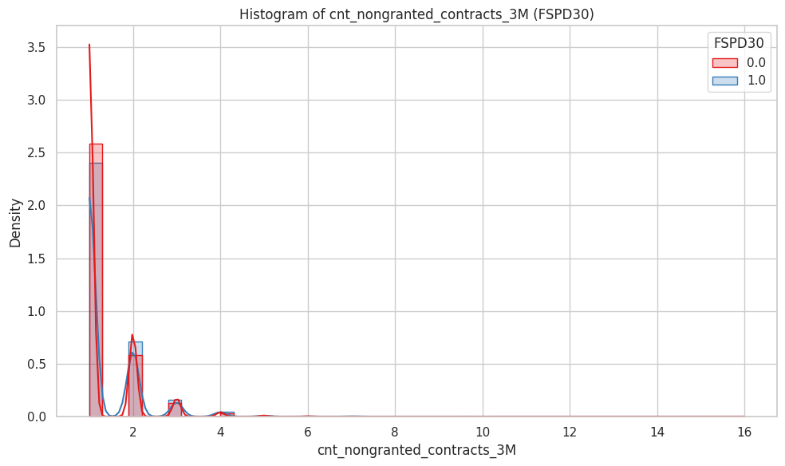
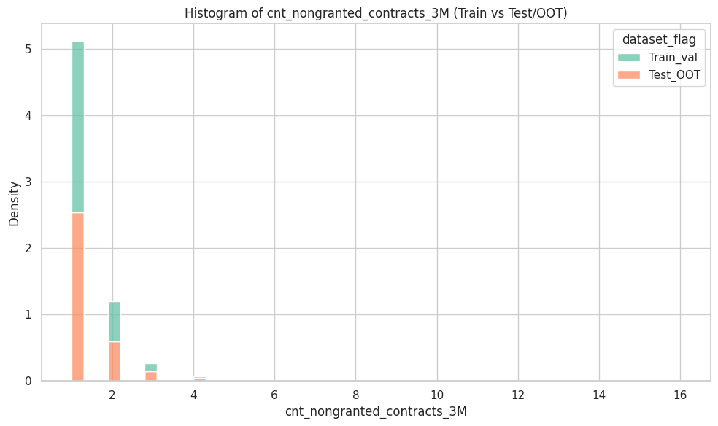
Rank# 5: cnt_nongranted_contracts_3M (2 / 6) - Histogram <Disbursed>
Train and test datasets are very well aligned. Most records fall between 1 and 3 non-granted contracts, with rare values beyond that. No significant distribution shift is observed.
Both groups cluster tightly around 1–3 counts. Good customers (red) show slightly higher density at count = 1, while bad customers (blue) have minor peaks at higher values. Distribution is right-skewed but with discrete peaks.
33

Slide 34
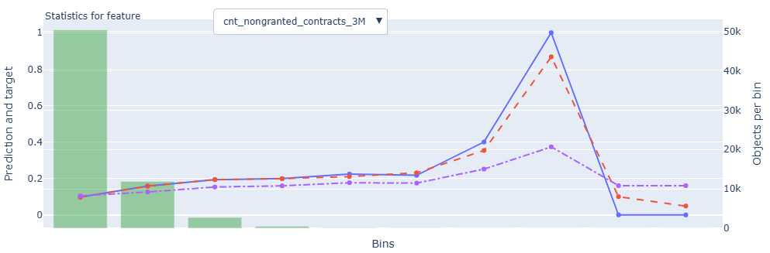
Rank# 5: cnt_nongranted_contracts_3M (3 / 6) - Feature Statistics Analysis <Disbursed>​
The red line closely follows the blue line across most bins, showing prediction reliability.
There is a clear upward trend in risk with increasing values, supporting this feature’s relevance and monotonic behavior.
The red–purple separation supports this feature’s moderate predictive power.
34

Slide 35
Rank# 5: cnt_nongranted_contracts_3M (4 / 6) - MoM Feature Distribution <Applied>​
cnt_nongranted_contracts_3M | Applied Count | Approval Rate | Mean |  | Avg. CIC Score
2024-09 | 17,501 | 64.3% | 1.27 |  | 0.1174
2024-10 | 16,814 | 63.7% | 1.27 |  | 0.1166
2024-11 | 17,923 | 66.5% | 1.30 |  | 0.1147
2024-12 | 33,533 | 64.5% | 1.31 |  | 0.1154
2025-01 | 16,420 | 62.1% | 1.33 |  | 0.1172
2025-02 | 14,246 | 63.8% | 1.34 |  | 0.1153
2025-03 | 17,650 | 65.4% | 1.34 |  | 0.1125
2025-04 | 19,545 | 66.6% | 1.40 |  | 0.1102
2025-05 | 20,487 | 65.5% | 1.33 |  | 0.1091
2025-06 | 18,006 | 67.6% | 1.34 |  | 0.1086
2025-07 | 16,595 | 67.0% | 1.33 |  | 0.1098
The mean count increases gradually from 1.27 in Sep 2024 to a peak of 1.40 in Apr 2025, followed by stabilization around 1.33–1.34 through Jul 2025.
The distribution shifts smoothly without abrupt changes, indicating a steady rise in non-granted contract interactions over time.
The feature demonstrates consistent progression month-over-month, supporting its suitability for modeling.
35

Slide 36
Rank# 5: cnt_nongranted_contracts_3M (5 / 6) - MoM Feature Distribution <Applied>​
New Applicant
cnt_nongranted_contracts_3M | Applied Count | Approval Rate | Mean |  | Avg. CIC Score
2024-09 | 16,893 | 64.0% | 1.27 |  | 0.1200
2024-10 | 16,095 | 63.1% | 1.27 |  | 0.1199
2024-11 | 16,954 | 65.7% | 1.3 |  | 0.1187
2024-12 | 32,289 | 64.5% | 1.31 |  | 0.1180
2025-01 | 15,691 | 62.3% | 1.33 |  | 0.1205
2025-02 | 13,474 | 64.1% | 1.35 |  | 0.1194
2025-03 | 16,626 | 65.4% | 1.35 |  | 0.1167
2025-04 | 18,390 | 66.5% | 1.4 |  | 0.1144
2025-05 | 19,503 | 65.5% | 1.33 |  | 0.1124
2025-06 | 17,011 | 67.5% | 1.35 |  | 0.1124
2025-07 | 15,811 | 66.5% | 1.33 |  | 0.1131
Repeat Applicant
cnt_nongranted_contracts_3M | Applied Count | Approval Rate | Mean |  | Avg. CIC Score
2024-09 | 608 | 74.2% | 1.23 |  | 0.0444
2024-10 | 719 | 76.9% | 1.30 |  | 0.0445
2024-11 | 969 | 81.1% | 1.26 |  | 0.0453
2024-12 | 1,244 | 65.6% | 1.36 |  | 0.0474
2025-01 | 729 | 58.8% | 1.40 |  | 0.0457
2025-02 | 772 | 57.3% | 1.26 |  | 0.0443
2025-03 | 1,024 | 64.1% | 1.28 |  | 0.0442
2025-04 | 1,155 | 67.8% | 1.31 |  | 0.0438
2025-05 | 984 | 65.3% | 1.24 |  | 0.0443
2025-06 | 995 | 69.8% | 1.28 |  | 0.0434
2025-07 | 784 | 76.7% | 1.28 |  | 0.0426
New applicants show a similar rising trend, with the mean growing from 1.27 to 1.40 by Apr 2025 and stabilizing at 1.33–1.35 afterward.
The change is steady and well-controlled, with no volatility or structural shifts across the months.
The feature maintains distributional stability and reflects predictable applicant behavior across the observation window.
Repeat applicants display more fluctuation, with the mean rising from 1.23 to 1.40 between Sep 2024 and Jan 2025, then oscillating mildly between 1.24 and 1.31.
Despite smaller volumes, the month-over-month trend remains smooth and without erratic spikes.
Overall, the distribution retains coherence, confirming the feature's reliability for repeat user modeling.
36

Slide 37
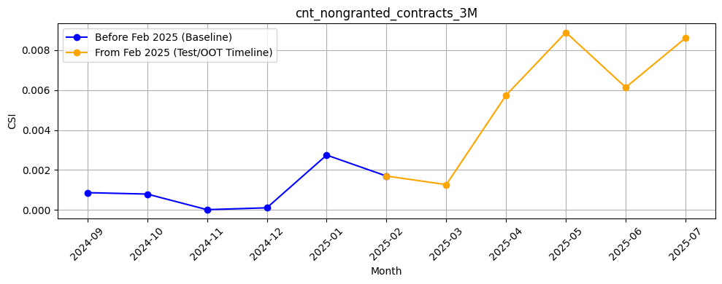
Rank# 5: cnt_nongranted_contracts_3M (6 / 6) - Feature CSI Analysis <Applied>​
Baseline period: Sep’2024 to Jan’2025.
CSI for cnt_nongranted_contracts_3M stayed low and stable during training, between ~0.00 and ~0.003. In the Test/OOT period (Feb to Jul 2025), CSI gradually increased from ~0.002 in Feb to ~0.009 in Jul. Although still within acceptable limits, the consistent rise indicates mild drift that should be monitored.
37

Slide 38
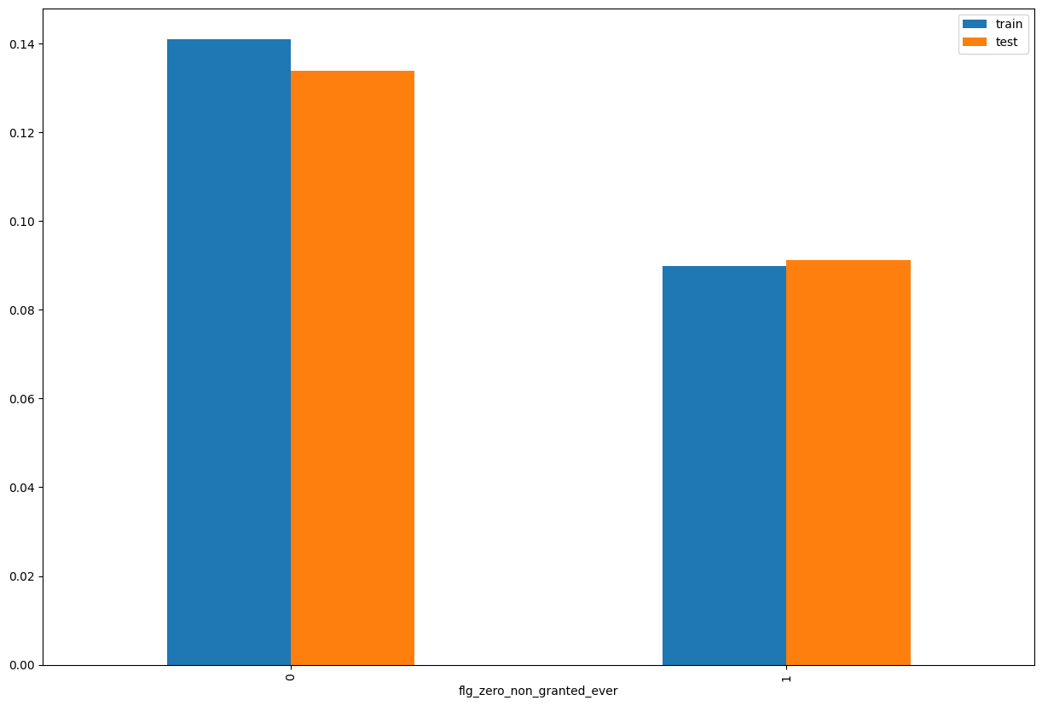
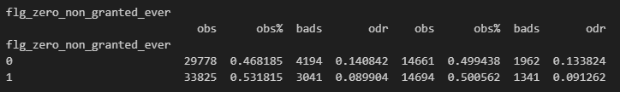
Rank# 6: flg_zero_non_granted_ever (1 / 4) - Performance in Train vs Test <Disbursed>
A flag (likely 1/0) that indicates whether the customer never had any loan applications rejected (i.e., non-granted contracts = 0).​
38
Please note these are just WOE Bins, NOT the final Bins that Catboost chooses internally

Slide 39
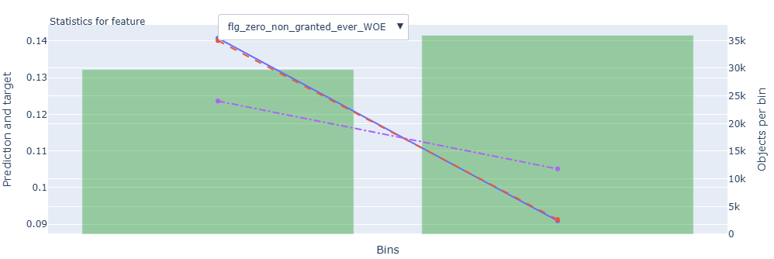
Rank# 6: flg_zero_non_granted_ever (2 / 4) - Feature Statistics Analysis <Disbursed>​
The red line follows the blue line reasonably well, showing the model captures the pattern in this feature.
There is a visible gap between the red and purple lines, which means the feature helps improve prediction accuracy.
The target shows a slight downward trend as average credit limit increases, which supports this feature’s relevance in the model.
39

Slide 40
Rank# 6: flg_zero_non_granted_ever (3 / 4) - MoM Feature Distribution <Applied>​
flg_zero_non_granted_ever | Applied Count | Approval Rate | 0 | 1 |  | Avg. CIC Score
2024-09 | 17,501 | 64.3% | 51.4% | 48.6% |  | 0.1174
2024-10 | 16,814 | 63.7% | 52.7% | 47.3% |  | 0.1166
2024-11 | 17,923 | 66.5% | 54.6% | 45.4% |  | 0.1147
2024-12 | 33,533 | 64.5% | 54.1% | 45.9% |  | 0.1154
2025-01 | 16,420 | 62.1% | 56.6% | 43.4% |  | 0.1172
2025-02 | 14,246 | 63.8% | 57.6% | 42.4% |  | 0.1153
2025-03 | 17,650 | 65.4% | 58.7% | 41.3% |  | 0.1125
2025-04 | 19,545 | 66.6% | 59.3% | 40.7% |  | 0.1102
2025-05 | 20,487 | 65.5% | 58.6% | 41.4% |  | 0.1091
2025-06 | 18,006 | 67.6% | 60.4% | 39.6% |  | 0.1086
2025-07 | 16,595 | 67.0% | 61.1% | 38.9% |  | 0.1098
The share of users with zero non-granted history ("1") gradually declines from 48.6% in Sep 2024 to 38.9% by Jul 2025, while the "0" group increases from 51.4% to 61.1%.
This shift is steady and directional, with no abrupt changes across months.
The clear and progressive distribution pattern reinforces the feature's modeling consistency.
40

Slide 41
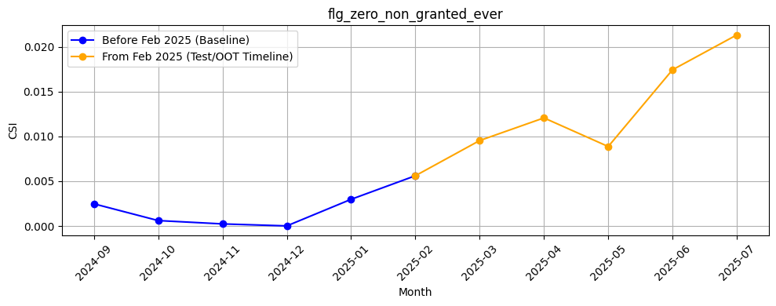
Rank# 6: flg_zero_non_granted_ever (4 / 4) - Feature CSI Analysis <Applied>​
Baseline period: Sep’2024 to Jan’2025.
CSI for flg_zero_non_granted_ever was negligible during training, ranging from ~0.00 to ~0.003. In the Test/OOT period (Feb to Jul 2025), CSI values rose steadily from ~0.006 in Feb to ~0.021 in Jul. While still under the 0.1 threshold, the consistent increase highlights early signs of feature drift, suggesting a need for close monitoring.
41

Slide 42
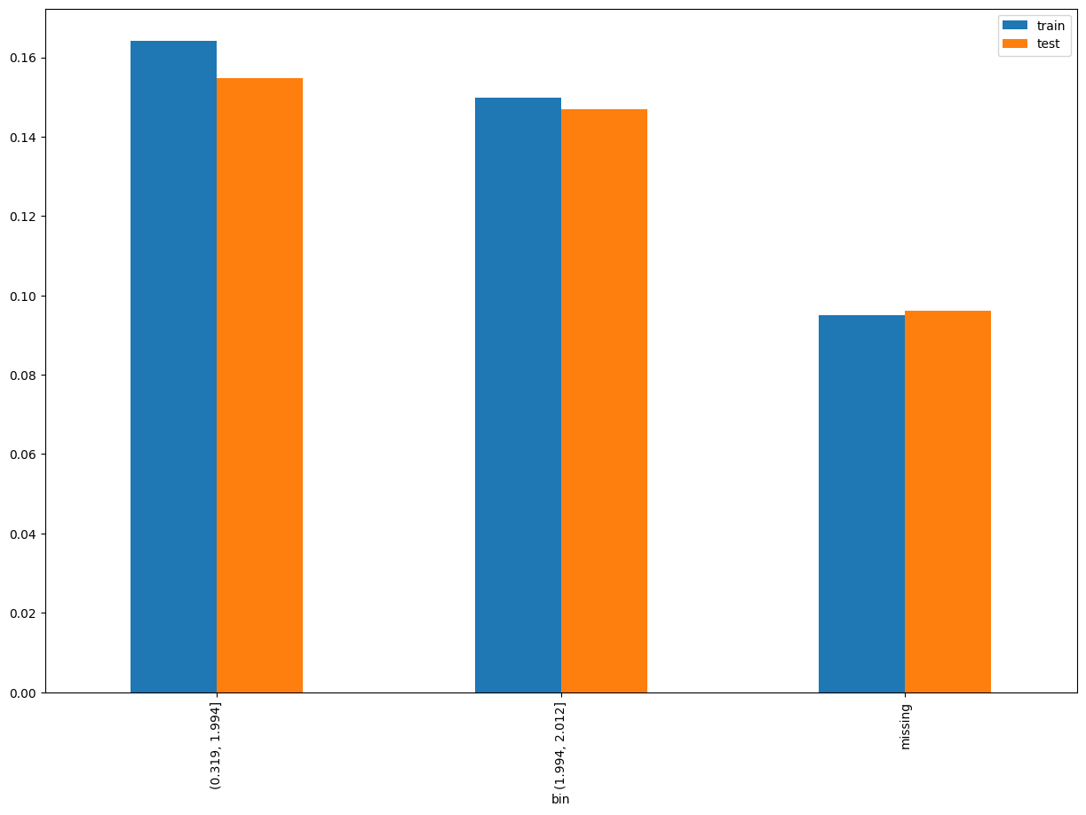
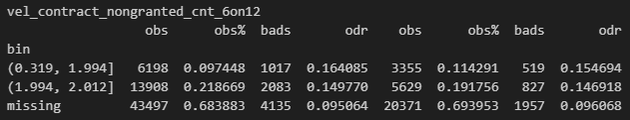
Rank# 7: vel_contract_nongranted_cnt_6on12 (1 / 5) - Performance in Train vs Test <Disbursed>
Velocity count of non granted contracts 6M on 12M
42
Please note these are just WOE Bins, NOT the final Bins that Catboost chooses internally

Slide 43
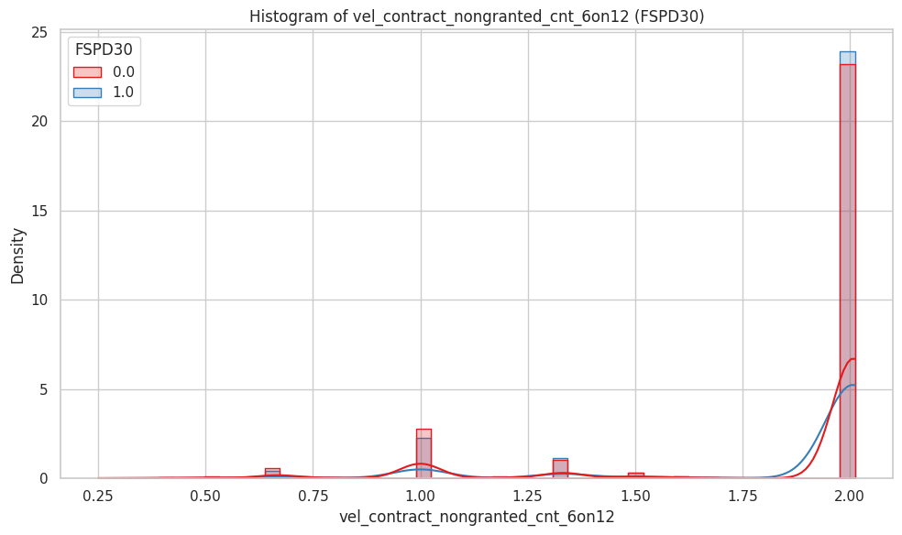
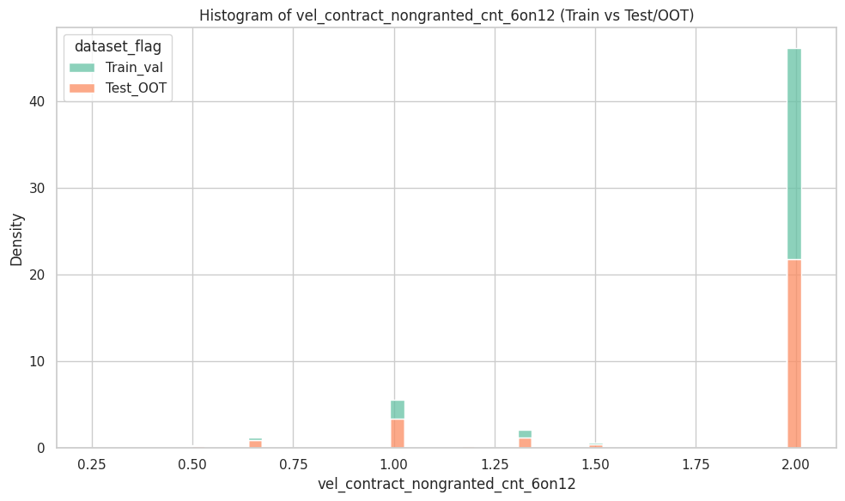
Rank# 7: vel_contract_nongranted_cnt_6on12 (2 / 5) - Histogram <Disbursed>
Train and test distributions are highly consistent, with a dominant spike at 2.0. The rest of the values are sparsely distributed, indicating strong feature stability across datasets.
Distributions are sharply peaked at 2.0 for both groups, with minor differences at lower values. Good customers (red) show slightly stronger density at the peak, while bad customers (blue) appear more spread in the lower range.
43

Slide 44
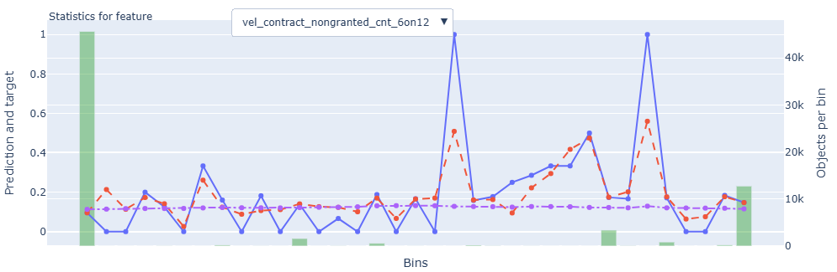
Rank# 7: vel_contract_nongranted_cnt_6on12 (3 / 5) - Feature Statistics Analysis <Disbursed>​
The red prediction line follows the blue target trend well in key regions, reflecting learned patterns.
Spikes in both prediction and target at higher bins indicate the model is responsive to risk signals in this feature.
Consistent purple line across bins shows stable data availability, making the feature usable and informative in the model.
44

Slide 45
Rank# 7: vel_contract_nongranted_cnt_6on12 (4 / 5) - MoM Feature Distribution <Applied>​
vel_contract_nongranted_cnt_6on12 | Applied Count | Approval Rate | Mean |  | Avg. CIC Score
2024-09 | 17,501 | 64.3% | 1.91 |  | 0.1174
2024-10 | 16,814 | 63.7% | 1.91 |  | 0.1166
2024-11 | 17,923 | 66.5% | 1.88 |  | 0.1147
2024-12 | 33,533 | 64.5% | 1.88 |  | 0.1154
2025-01 | 16,420 | 62.1% | 1.85 |  | 0.1172
2025-02 | 14,246 | 63.8% | 1.83 |  | 0.1153
2025-03 | 17,650 | 65.4% | 1.82 |  | 0.1125
2025-04 | 19,545 | 66.6% | 1.79 |  | 0.1102
2025-05 | 20,487 | 65.5% | 1.78 |  | 0.1091
2025-06 | 18,006 | 67.6% | 1.75 |  | 0.1086
2025-07 | 16,595 | 67.0% | 1.76 |  | 0.1098
The mean value declines smoothly from 1.91 in Sep–Oct 2024 to 1.76 by Jul 2025, indicating a gradual decrease in non-granted contract activity.
Month-over-month changes are minimal, maintaining a stable slope.
The trend is consistent and predictable, supporting strong temporal reliability.
45

Slide 46
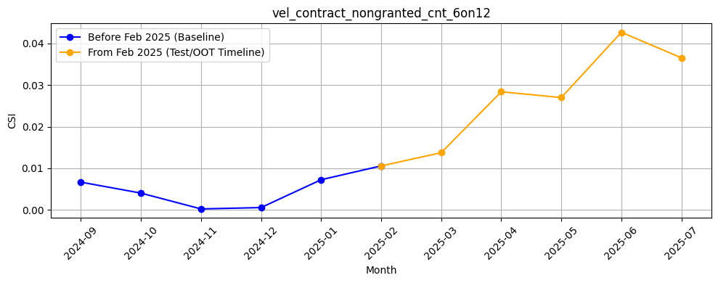
Rank# 7: vel_contract_nongranted_cnt_6on12 (5 / 5) - Feature CSI Analysis <Applied>​
Baseline period: Sep’2024 to Jan’2025.
CSI for vel_contract_nongranted_cnt_6on12 showed a gradual increase during training, starting from ~0.007 in Sep 2024 to ~0.010 in Jan 2025. In the Test/OOT period (Feb to Jul 2025), CSI values continued to rise steadily, peaking at ~0.043 in Jun 2025 before slightly easing to ~0.037 in Jul 2025. The upward trend indicates emerging drift and warrants monitoring.
46

Slide 47
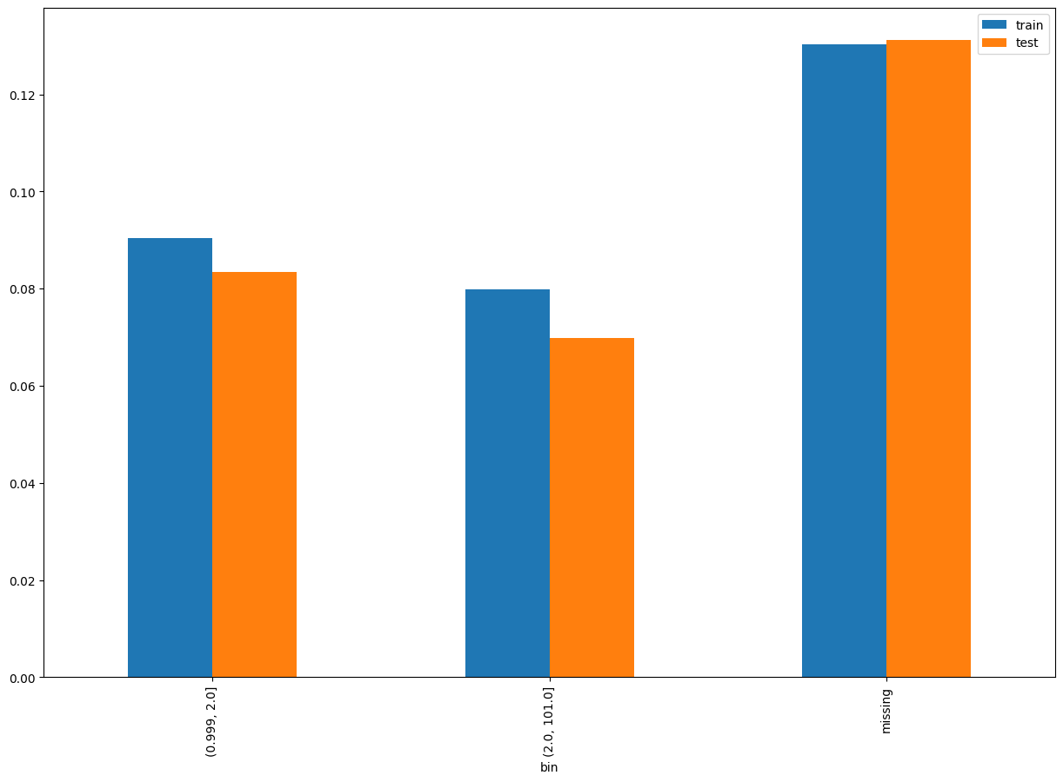
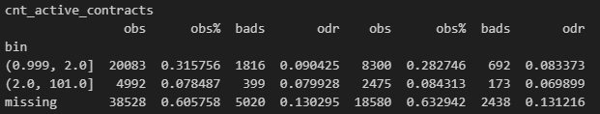
Rank# 8: cnt_active_contracts (1 / 5) - Performance in Train vs Test <Disbursed>
Count of total active contract
47
Please note these are just WOE Bins, NOT the final Bins that Catboost chooses internally

Slide 48
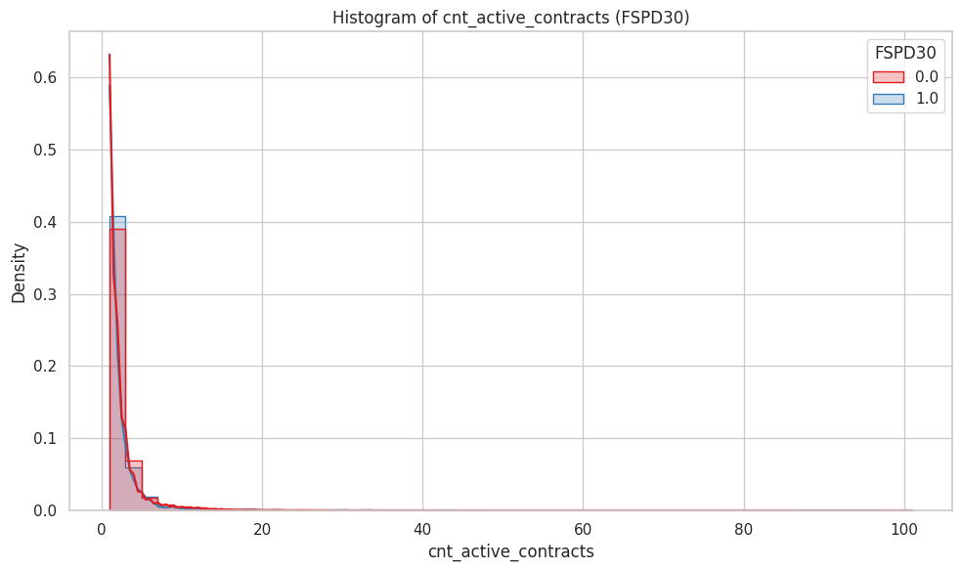
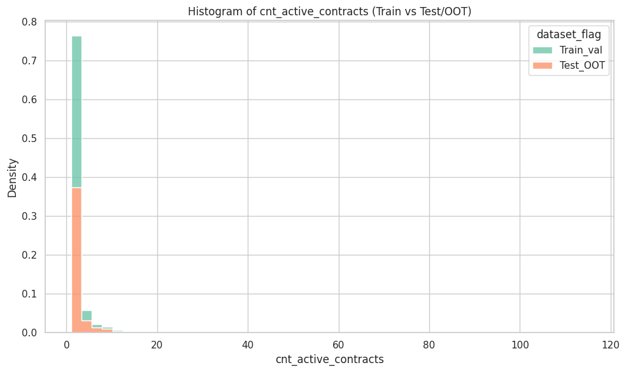
Rank# 8: cnt_active_contracts (2 / 5) - Histogram <Disbursed>
Distributions are well aligned. Majority of data is under 10 active contracts, with a long but sparse tail. Feature shows no significant shift across datasets.
Both groups are right-skewed, with most values concentrated between 0 and 5. Good customers (red) have a slightly flatter decline, suggesting marginally more active contracts on average.
48

Slide 49
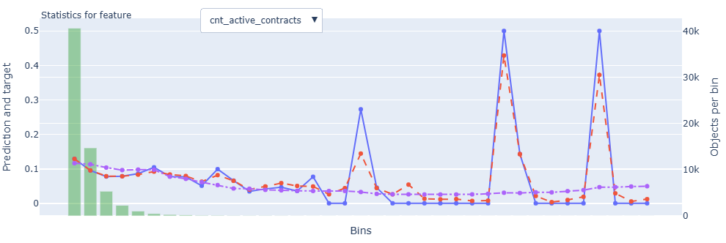
Rank# 8: cnt_active_contracts (3 / 5) - Feature Statistics Analysis <Disbursed>​
The red prediction line aligns closely with the blue target across most bins, showing consistent model behavior.
The pattern reveals a smooth downward trend in risk with more active contracts, supporting logical predictive value.
Stable object distribution (purple line) across bins ensures reliability, making this a strong and stable feature for modeling.
49

Slide 50
Rank# 8: cnt_active_contracts (4 / 5) - MoM Feature Distribution <Applied>​
cnt_active_contracts | Applied Count | Approval Rate | Mean |  | Avg. CIC Score
2024-09 | 17,501 | 64.3% | 2.03 |  | 0.1174
2024-10 | 16,814 | 63.7% | 2.04 |  | 0.1166
2024-11 | 17,923 | 66.5% | 1.97 |  | 0.1147
2024-12 | 33,533 | 64.5% | 1.97 |  | 0.1154
2025-01 | 16,420 | 62.1% | 1.89 |  | 0.1172
2025-02 | 14,246 | 63.8% | 2.08 |  | 0.1153
2025-03 | 17,650 | 65.4% | 2.18 |  | 0.1125
2025-04 | 19,545 | 66.6% | 2.28 |  | 0.1102
2025-05 | 20,487 | 65.5% | 2.38 |  | 0.1091
2025-06 | 18,006 | 67.6% | 2.58 |  | 0.1086
2025-07 | 16,595 | 67.0% | 2.61 |  | 0.1098
The mean active contracts increase consistently from 2.03 in Sep 2024 to 2.61 by Jul 2025, showing a clear upward trajectory.
The progression is smooth and uninterrupted, reflecting portfolio growth.
The feature displays excellent directional stability, ideal for modeling exposure or utilization patterns.
50

Slide 51
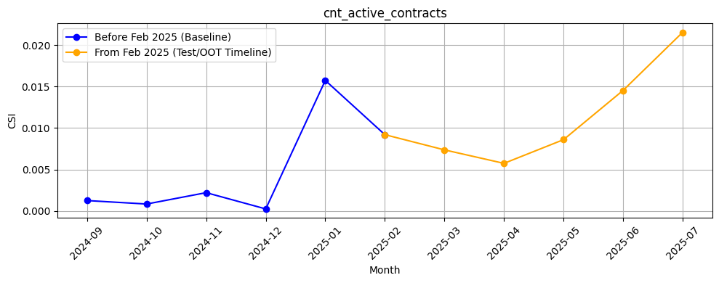
Rank# 8: cnt_active_contracts (5 / 5) - Feature CSI Analysis <Applied>​
Baseline period: Sep’2024 to Jan’2025.
CSI for cnt_active_contracts remained low and stable during training, fluctuating within ~0.0005 to ~0.002. However, during the Test/OOT period (Feb to Jul 2025), CSI gradually increased, reaching ~0.021 by Jul 2025. While values remained below the drift threshold, the consistent upward trend suggests mild drift signals.
51

Slide 52
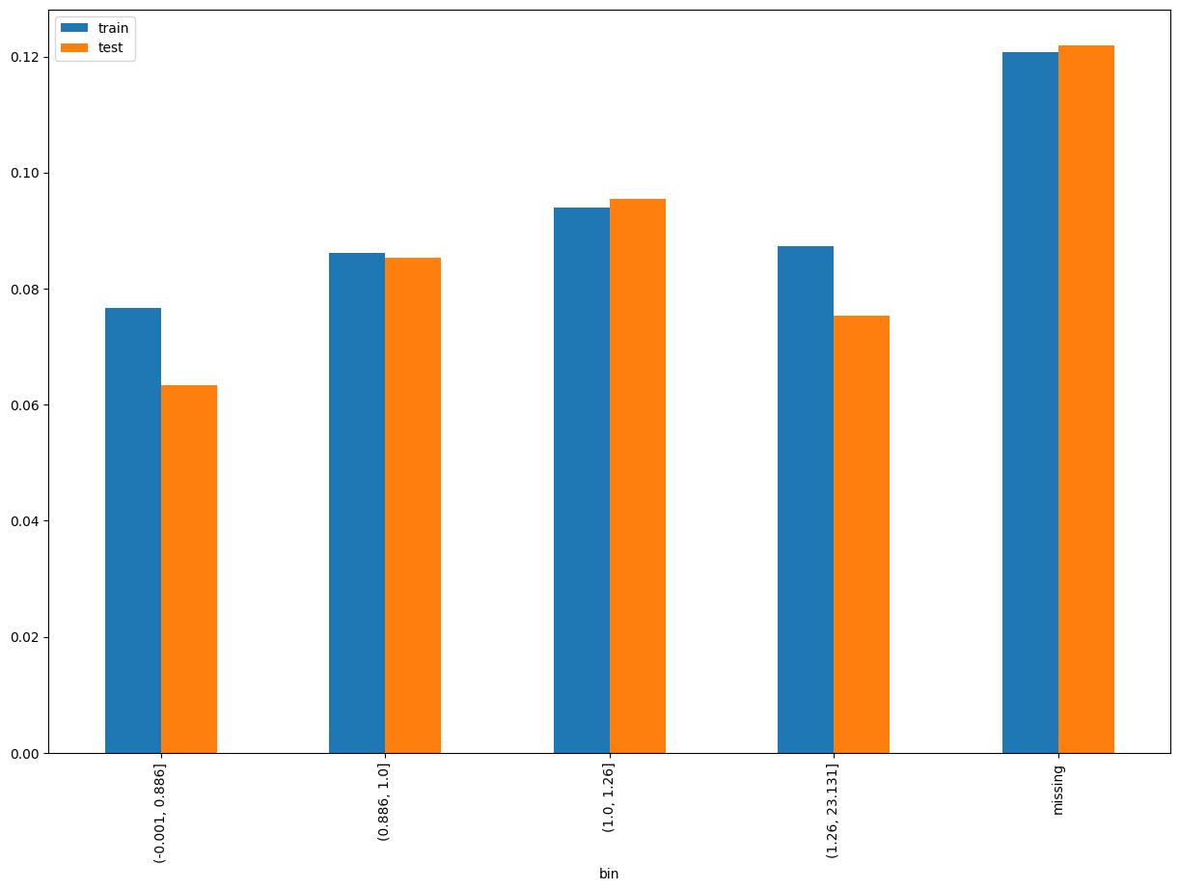
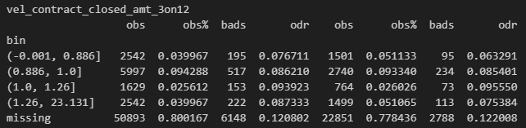
Rank# 9: vel_contract_closed_amt_3on12 (1 / 5) - Performance in Train vs Test <Disbursed>
Velocity amount of closed granted contracts 3M on 12M
52
Please note these are just WOE Bins, NOT the final Bins that Catboost chooses internally

Slide 53
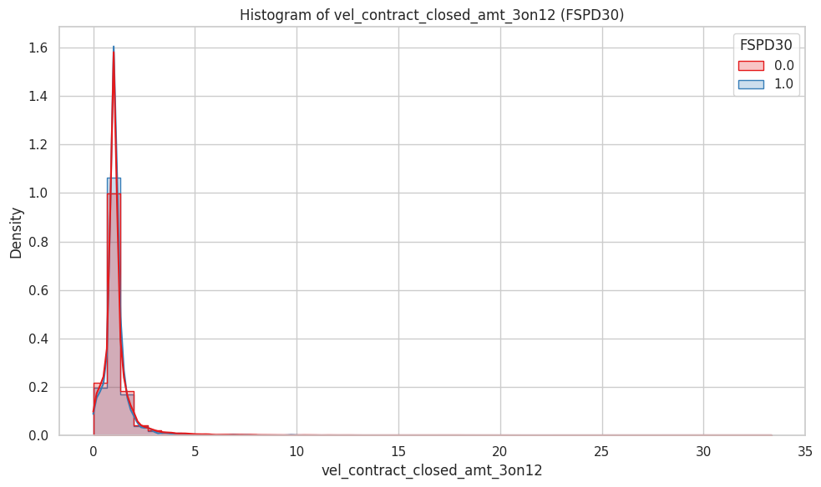
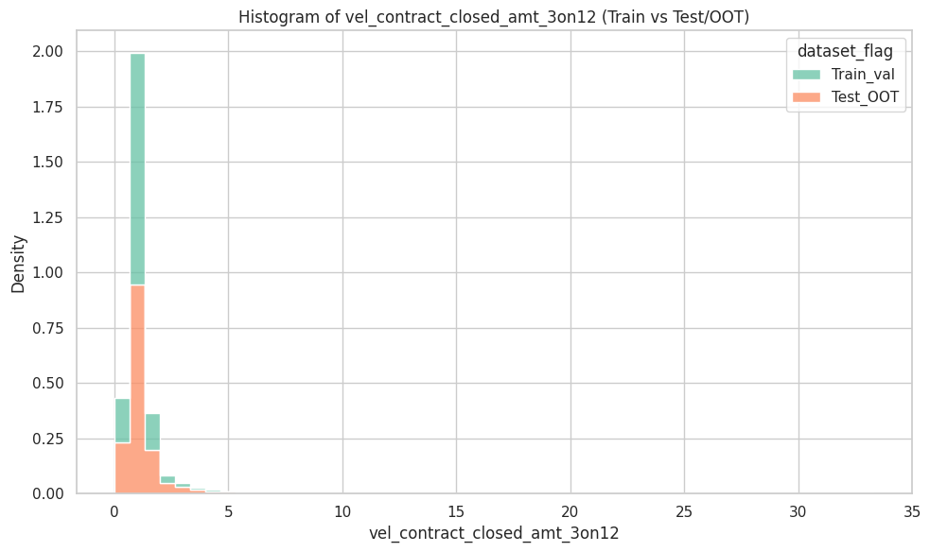
Rank# 9: vel_contract_closed_amt_3on12 (2 / 5) - Histogram <Disbursed>
Distributions are well matched. Majority of values lie below 2, with rare outliers extending beyond 30. Feature appears stable across datasets.
Both groups are highly concentrated near zero with a steep right-skew. Good customers (red) show a slightly sharper peak, while bad customers (blue) appear more spread in the lower range.
53

Slide 54
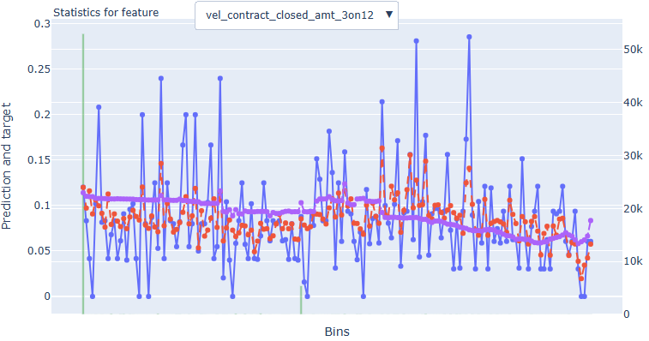
Rank# 9: vel_contract_closed_amt_3on12 (3 / 5) - Feature Statistics Analysis <Disbursed>​
The red prediction line aligns closely with the blue target line across bins, demonstrating the model’s ability to learn from this feature.
Overall stability and trend consistency indicate predictive value.
The purple object distribution line remains steady, supporting the feature’s robustness and reliability for model inclusion.
54

Slide 55
Rank# 9: vel_contract_closed_amt_3on12 (4 / 5) - MoM Feature Distribution <Applied>​
vel_contract_closed_amt_3on12 | Applied Count | Approval Rate | Mean |  | Avg. CIC Score
2024-09 | 17,501 | 64.3% | 1.07 |  | 0.1174
2024-10 | 16,814 | 63.7% | 1.11 |  | 0.1166
2024-11 | 17,923 | 66.5% | 1.16 |  | 0.1147
2024-12 | 33,533 | 64.5% | 1.14 |  | 0.1154
2025-01 | 16,420 | 62.1% | 1.17 |  | 0.1172
2025-02 | 14,246 | 63.8% | 1.14 |  | 0.1153
2025-03 | 17,650 | 65.4% | 1.20 |  | 0.1125
2025-04 | 19,545 | 66.6% | 1.19 |  | 0.1102
2025-05 | 20,487 | 65.5% | 1.26 |  | 0.1091
2025-06 | 18,006 | 67.6% | 1.27 |  | 0.1086
2025-07 | 16,595 | 67.0% | 1.23 |  | 0.1098
The mean closed contract amount shows a gentle rise from 1.07 in Sep 2024 to 1.23 in Jul 2025, with only minor fluctuations.
No volatility is observed, and the changes follow a stable, upward trend.
This confirms the feature’s consistency and suitability for temporal modeling.
55

Slide 56

Rank# 9: vel_contract_closed_amt_3on12 (5 / 5) - Feature CSI Analysis <Applied>​
Baseline period: Sep’2024 to Jan’2025.
CSI for vel_contract_closed_amt_3on12 was low and stable during training (~0.0005 to ~0.005). In the Test/OOT period (Feb to Jul 2025), CSI increased gradually and peaked at ~0.020 by Jul 2025. Though still under the 0.1 threshold, the upward trajectory indicates potential drift development.
56

Slide 57


Rank# 10: vel_contract_granted_amt_6on12 (1 / 5) - Performance in Train vs Test <Disbursed>
Velocity amount of granted contracts 6M on 12M
57
Please note these are just WOE Bins, NOT the final Bins that Catboost chooses internally

Slide 58


Rank# 10: vel_contract_granted_amt_6on12 (2 / 5) - Histogram <Disbursed>
Train and test distributions are closely aligned. Most values fall below 3, with rare outliers up to 30. Feature shows strong stability across datasets.
Distributions are right-skewed and similar across both classes. Good customers (red) show slightly more density around the central peak, while bad customers (blue) have marginally heavier tails.
58

Slide 59

Rank# 10: vel_contract_granted_amt_6on12 (3 / 5) - Feature Statistics Analysis <Disbursed>​
The prediction (red) line closely follows the actual target (blue), indicating good alignment and model learning across bins.
There’s a slightly upward trend in both prediction and target values, suggesting that higher velocity in granted amounts is mildly associated with increased risk.
A stable and gradually increasing object count (purple) across bins reinforces the reliability and stability of this feature for modeling.
59

Slide 60
Rank# 10: vel_contract_granted_amt_6on12 (4 / 5) - MoM Feature Distribution <Applied>​
vel_contract_granted_amt_6on12 | Applied Count | Approval Rate | Mean |  | Avg. CIC Score
2024-09 | 17,501 | 64.3% | 1.02 |  | 0.1174
2024-10 | 16,814 | 63.7% | 1.04 |  | 0.1166
2024-11 | 17,923 | 66.5% | 1.07 |  | 0.1147
2024-12 | 33,533 | 64.5% | 1.05 |  | 0.1154
2025-01 | 16,420 | 62.1% | 1.08 |  | 0.1172
2025-02 | 14,246 | 63.8% | 1.10 |  | 0.1153
2025-03 | 17,650 | 65.4% | 1.11 |  | 0.1125
2025-04 | 19,545 | 66.6% | 1.13 |  | 0.1102
2025-05 | 20,487 | 65.5% | 1.11 |  | 0.1091
2025-06 | 18,006 | 67.6% | 1.11 |  | 0.1086
2025-07 | 16,595 | 67.0% | 1.15 |  | 0.1098
The mean steadily increases from 1.02 in Sep 2024 to 1.15 in Jul 2025, with small and controlled monthly changes.
The upward trend is linear and smooth, with no reversals or spikes.
This reflects healthy feature behavior over time and supports modeling confidence.
60

Slide 61

Rank# 10: vel_contract_granted_amt_6on12 (5 / 5) - Feature CSI Analysis <Applied>​
Baseline period: Sep’2024 to Jan’2025.
CSI for vel_contract_granted_amt_6on12 stayed low during the training period (~0.0007 to ~0.006). Post Feb 2025, the metric showed a steady increase, peaking at ~0.011 in both Apr and Jul 2025. While the values are within limits, the rising pattern suggests a trend toward distributional shift.
61

Slide 62


Rank# 11: max_amt_granted_24M (1 / 5) - Performance in Train vs Test <Disbursed>
Maximum amount granted in the last 24 months.​
62
Please note these are just WOE Bins, NOT the final Bins that Catboost chooses internally

Slide 63


Rank# 11: max_amt_granted_24M (2 / 5) - Histogram <Disbursed>
Train and test sets are well aligned. Long tails extend beyond 7 million, but such values are rare. Feature distribution is stable across datasets.
Both distributions are extremely right-skewed, with most values below 200,000. Good (red) and bad (blue) customers show nearly identical patterns, offering minimal separation.
63

Slide 64

Rank# 11: max_amt_granted_24M (3 / 5) - Feature Statistics Analysis <Disbursed>​
The prediction (red) and target (blue) lines are generally aligned, indicating the model effectively captures risk signals from this feature.
There's a slightly upward trend in the lower-to-mid bins, suggesting higher granted amounts may be mildly associated with increased risk.
Stable object distribution (purple) across bins enhances the feature’s reliability and supports its inclusion in the model.
64

Slide 65
Rank# 11: max_amt_granted_24M (4 / 5) - MoM Feature Distribution <Applied>​
max_amt_granted_24M | Applied Count | Approval Rate | Mean |  | Avg. CIC Score
2024-09 | 17,501 | 64.3% | 43561.8 |  | 0.1174
2024-10 | 16,814 | 63.7% | 45804.2 |  | 0.1166
2024-11 | 17,923 | 66.5% | 50431.7 |  | 0.1147
2024-12 | 33,533 | 64.5% | 44117.7 |  | 0.1154
2025-01 | 16,420 | 62.1% | 41442.8 |  | 0.1172
2025-02 | 14,246 | 63.8% | 45386.7 |  | 0.1153
2025-03 | 17,650 | 65.4% | 48266.2 |  | 0.1125
2025-04 | 19,545 | 66.6% | 49516.1 |  | 0.1102
2025-05 | 20,487 | 65.5% | 53463.5 |  | 0.1091
2025-06 | 18,006 | 67.6% | 48398.1 |  | 0.1086
2025-07 | 16,595 | 67.0% | 49085.6 |  | 0.1098
The mean granted amount trends upward from ~43.6K in Sep 2024 to a peak of ~53.5K in May 2025, before slightly dipping to ~49K in Jul 2025.
The trend is consistent and directional, reflecting a steady growth in high-limit credit approvals.
Overall, the feature shows strong progressive movement with no erratic shifts.
65

Slide 66

Rank# 11: max_amt_granted_24M (5 / 5) - Feature CSI Analysis <Applied>​
Baseline period: Sep’2024 to Jan’2025.
CSI for max_amt_granted_24M remained low and steady throughout training, with values between ~0.0003 to ~0.006. In the Test/OOT period (Feb to Jul 2025), CSI increased consistently and reached ~0.030 by Jul 2025. Although still below the drift threshold, this persistent rise may signal emerging instability in the feature’s distribution.
66

Slide 67


Rank# 12: tot_active_contracts_util (1 / 5) - Performance in Train vs Test <Disbursed>
Total outstanding balance / total sanctioned amount(FinancedAmount + CreditLimit)
67
Please note these are just WOE Bins, NOT the final Bins that Catboost chooses internally

Slide 68


Rank# 12: tot_active_contracts_util (2 / 5) - Histogram <Disbursed>
Distributions align well, with the majority of values near zero. Sparse tail extends far right, but no visible drift between training and test sets.
Highly right-skewed for both classes. Good customers (red) peak slightly higher near zero, while bad customers (blue) show a broader low-range spread. Outliers above 100 exist but are rare.
68

Slide 69

Rank# 12: tot_active_contracts_util (3 / 5) - Feature Statistics Analysis <Disbursed>​
The red prediction line closely tracks the blue target trend across bins, reflecting consistent model behavior.
There's a clear upward trend indicating a strong positive correlation between utilization and risk.
With a smooth and stable object distribution (purple), the feature demonstrates high predictive value and robustness.
69

Slide 70
Rank# 12: tot_active_contracts_util (4 / 5) - MoM Feature Distribution <Applied>​
tot_active_contracts_util | Applied Count | Approval Rate | Mean |  | Avg. CIC Score
2024-09 | 17,501 | 64.3% | 0.84 |  | 0.1174
2024-10 | 16,814 | 63.7% | 0.85 |  | 0.1166
2024-11 | 17,923 | 66.5% | 0.86 |  | 0.1147
2024-12 | 33,533 | 64.5% | 0.89 |  | 0.1154
2025-01 | 16,420 | 62.1% | 0.83 |  | 0.1172
2025-02 | 14,246 | 63.8% | 0.77 |  | 0.1153
2025-03 | 17,650 | 65.4% | 0.72 |  | 0.1125
2025-04 | 19,545 | 66.6% | 0.78 |  | 0.1102
2025-05 | 20,487 | 65.5% | 0.69 |  | 0.1091
2025-06 | 18,006 | 67.6% | 0.71 |  | 0.1086
2025-07 | 16,595 | 67.0% | 0.71 |  | 0.1098
Utilization starts at 0.84–0.89 through Dec 2024 and gradually drops to ~0.71 by Jul 2025.
The declining pattern is smooth and controlled, with no volatility or sharp deviations.
The consistent downward trend suggests a stable feature that adapts predictably with user behavior.
70

Slide 71

Rank# 12: tot_active_contracts_util (5 / 5) - Feature CSI Analysis <Applied>​
Baseline period: Sep’2024 to Jan’2025.
CSI for tot_active_contracts_util ranged from ~0.0012 to ~0.0085, indicating baseline variability. During the Test/OOT period (Feb 2025 to Jul 2025), CSI ranged from ~0.0096 to ~0.0475, indicating good stability.
71

Slide 72


Rank# 13: total_overdue_granted_contracts (1 / 5) - Performance in Train vs Test <Disbursed>
Total number of overdue contracts for this account
72
Please note these are just WOE Bins, NOT the final Bins that Catboost chooses internally

Slide 73


Rank# 13: total_overdue_granted_contracts (2 / 5) - Histogram <Disbursed>
Distributions are closely aligned. Most values are under 5, with rare outliers beyond 70. Feature is stable across datasets.
Both groups are right-skewed and concentrated near zero. Bad customers (blue) show slightly more spread beyond 2, hinting at higher delinquency rates.
73

Slide 74

Rank# 13: total_overdue_granted_contracts (3 / 5) - Feature Statistics Analysis <Disbursed>​
The feature exhibits a clear upward trend in both prediction and target rates toward higher bins, indicating strong predictive power.
Model predictions (red) closely follow actual target behavior (blue), showing consistency and reliability.
The model adapts well—making this feature stable and valuable for risk discrimination.
74

Slide 75
Rank# 13: total_overdue_granted_contracts (4 / 5) - MoM Feature Distribution <Applied>​
total_overdue_granted_contracts | Applied Count | Approval Rate | Mean |  | Avg. CIC Score
2024-09 | 17,501 | 64.3% | 0.65 |  | 0.1174
2024-10 | 16,814 | 63.7% | 0.66 |  | 0.1166
2024-11 | 17,923 | 66.5% | 0.63 |  | 0.1147
2024-12 | 33,533 | 64.5% | 0.63 |  | 0.1154
2025-01 | 16,420 | 62.1% | 0.61 |  | 0.1172
2025-02 | 14,246 | 63.8% | 0.59 |  | 0.1153
2025-03 | 17,650 | 65.4% | 0.60 |  | 0.1125
2025-04 | 19,545 | 66.6% | 0.64 |  | 0.1102
2025-05 | 20,487 | 65.5% | 0.64 |  | 0.1091
2025-06 | 18,006 | 67.6% | 0.65 |  | 0.1086
2025-07 | 16,595 | 67.0% | 0.72 |  | 0.1098
The mean hovers around 0.59–0.66 for most months but spikes slightly to 0.72 in Jul 2025.
Despite the late uptick, the progression remains well-contained, with most changes within a narrow band.
The feature reflects a relatively stable trend with minor variation.
75

Slide 76

Rank# 13: total_overdue_granted_contracts (5 / 5) - Feature CSI Analysis <Applied>​
Baseline period: Sep’2024 to Jan’2025.
CSI for total_overdue_granted_contracts ranged from ~0.0001 to ~0.0065, indicating baseline variability. During the Test/OOT period (Feb 2025 to Jul 2025), CSI ranged from ~0.0011 to ~0.0089, indicating good stability.
76

Slide 77


Rank# 14: days_since_last_closed (1 / 5) - Performance in Train vs Test <Disbursed>
Days since last closed granted contracts
77
Please note these are just WOE Bins, NOT the final Bins that Catboost chooses internally

Slide 78


Rank# 14: days_since_last_closed (2 / 5) - Histogram <Disbursed>
Distributions are consistent across datasets. Most values fall under 2000 days, with a long but thin tail. No major shift observed.
Right-skewed for both classes. Good customers (red) are more concentrated near recent closures, while bad customers (blue) show a broader spread into older closures.
78

Slide 79

Rank# 14: days_since_last_closed (3 / 5) - Feature Statistics Analysis <Disbursed>​
The red line closely follows the blue line across most bins, showing prediction reliability.
There's a clear upward trend indicating a strong positive correlation .
The red–purple separation supports this feature’s moderate predictive power.
79

Slide 80
Rank# 14: days_since_last_closed (4 / 5) - MoM Feature Distribution <Applied>​
days_since_last_closed | Applied Count | Approval Rate | Mean |  | Avg. CIC Score
2024-09 | 17,501 | 64.3% | 607.9 |  | 0.1174
2024-10 | 16,814 | 63.7% | 595.4 |  | 0.1166
2024-11 | 17,923 | 66.5% | 591.6 |  | 0.1147
2024-12 | 33,533 | 64.5% | 600.9 |  | 0.1154
2025-01 | 16,420 | 62.1% | 559.6 |  | 0.1172
2025-02 | 14,246 | 63.8% | 549.1 |  | 0.1153
2025-03 | 17,650 | 65.4% | 547.0 |  | 0.1125
2025-04 | 19,545 | 66.6% | 550.5 |  | 0.1102
2025-05 | 20,487 | 65.5% | 566.0 |  | 0.1091
2025-06 | 18,006 | 67.6% | 559.7 |  | 0.1086
2025-07 | 16,595 | 67.0% | 546.3 |  | 0.1098
The mean steadily declines from ~608 days in Sep 2024 to ~546 days by Jul 2025, with a smooth drop from Jan onwards.
Month-over-month shifts are consistent and free from spikes.
The overall trend supports reliable temporal modeling with strong distributional stability.
80

Slide 81

Rank# 14: days_since_last_closed (5 / 5) - Feature CSI Analysis <Applied>​
Baseline period: Sep’2024 to Jan’2025.
CSI for days_since_last_closed ranged from ~0.0038 to ~0.0126, indicating baseline variability. During the Test/OOT period (Feb 2025 to Jul 2025), CSI ranged from ~0.022 to ~0.0500, indicating good stability.
81

Slide 82


Rank# 15: granted_contracts_cnt_6M (1 / 5) - Performance in Train vs Test <Disbursed>
Count of granted contracts in 6M
82
Please note these are just WOE Bins, NOT the final Bins that Catboost chooses internally

Slide 83


Rank# 15: granted_contracts_cnt_6M (2 / 5) - Histogram <Disbursed>
Distributions align well, with most values below 10. Very few outliers extend past 50. Feature is stable across datasets.
Both distributions are sharply right-skewed, concentrated between 0 and 5. Good (red) and bad (blue) customers show nearly identical patterns, offering limited class separation.
83

Slide 84

Rank# 15: granted_contracts_cnt_6M (3 / 5) - Feature Statistics Analysis <Disbursed>​
The red line closely follows the blue line across most bins, showing prediction reliability.
There’s a noticeable downward trend indicating inverse correlation with risk.
The red–purple separation supports this feature’s predictive power.
84

Slide 85
Rank# 15: granted_contracts_cnt_6M (4 / 5) - MoM Feature Distribution <Applied>​
granted_contracts_cnt_6M | Applied Count | Approval Rate | Mean |  | Avg. CIC Score
2024-09 | 17,501 | 64.3% | 2.65 |  | 0.1174
2024-10 | 16,814 | 63.7% | 2.32 |  | 0.1166
2024-11 | 17,923 | 66.5% | 2.13 |  | 0.1147
2024-12 | 33,533 | 64.5% | 2.35 |  | 0.1154
2025-01 | 16,420 | 62.1% | 2.17 |  | 0.1172
2025-02 | 14,246 | 63.8% | 2.12 |  | 0.1153
2025-03 | 17,650 | 65.4% | 2.22 |  | 0.1125
2025-04 | 19,545 | 66.6% | 2.19 |  | 0.1102
2025-05 | 20,487 | 65.5% | 2.14 |  | 0.1091
2025-06 | 18,006 | 67.6% | 2.37 |  | 0.1086
2025-07 | 16,595 | 67.0% | 2.58 |  | 0.1098
After dropping from 2.65 in Sep to 2.12–2.22 by Feb–Mar, the feature rises again to 2.58 in Jul 2025, forming a U-shaped trend.
The changes are gradual and consistent, with a clear recovery pattern post-Q1 2025.
Despite the shape, the distribution remains stable and interpretable.
85

Slide 86

Rank# 15: granted_contracts_cnt_6M (5 / 5) - Feature CSI Analysis <Applied>​
Baseline period: Sep’2024 to Jan’2025.
CSI for granted_contracts_cnt_6M ranged from ~0.0012 to ~0.0052, indicating baseline variability. During the Test/OOT period (Feb 2025 to Jul 2025), CSI ranged from ~0.0014 to ~0.0105, indicating good stability.
86

Slide 87


Rank# 16: flg_zero_granted_ever (1 / 4) - Performance in Train vs Test <Disbursed>
A flag that indicates the user never had any granted loans (i.e., granted contracts = 0).​
87
Please note these are just WOE Bins, NOT the final Bins that Catboost chooses internally

Slide 88

Rank# 16: flg_zero_granted_ever (2 / 4) - Feature Statistics Analysis <Disbursed>​
The red line (model prediction) matches the blue line (actual outcome), showing the model understands this feature well.
There is a visible gap between the red and purple lines, meaning this feature contributes to better predictions.
The green bars show a higher number of records for value 1 compared to 0
The target rate is slightly lower for value 1, making this a useful binary flag for the model.
88

Slide 89
Rank# 16: flg_zero_granted_ever (3 / 4) - MoM Feature Distribution <Applied>​
flg_zero_granted_ever | Applied Count | Approval Rate | 0 | 1 |  | Avg. CIC Score
2024-09 | 17,501 | 64.3% | 73.8% | 26.2% |  | 0.1174
2024-10 | 16,814 | 63.7% | 75.3% | 24.7% |  | 0.1166
2024-11 | 17,923 | 66.5% | 77.1% | 22.9% |  | 0.1147
2024-12 | 33,533 | 64.5% | 76.6% | 23.4% |  | 0.1154
2025-01 | 16,420 | 62.1% | 71.7% | 28.3% |  | 0.1172
2025-02 | 14,246 | 63.8% | 73.0% | 27.0% |  | 0.1153
2025-03 | 17,650 | 65.4% | 73.8% | 26.2% |  | 0.1125
2025-04 | 19,545 | 66.6% | 77.0% | 23.0% |  | 0.1102
2025-05 | 20,487 | 65.5% | 77.6% | 22.4% |  | 0.1091
2025-06 | 18,006 | 67.6% | 77.5% | 22.5% |  | 0.1086
2025-07 | 16,595 | 67.0% | 79.0% | 21.0% |  | 0.1098
The segment "0" grows from 73.8% in Sep 2024 to 79.0% in Jul 2025, while the "1" segment steadily declines.
The distribution changes are progressive and consistent across the entire period.
The trend indicates improving portfolio behavior and supports strong segmentation for modeling.
89

Slide 90

Rank# 16: flg_zero_granted_ever (4 / 4) - Feature CSI Analysis <Applied>​
Baseline period: Sep’2024 to Jan’2025.
CSI for flg_zero_granted_ever ranged from ~0.0000 to ~0.0065, indicating baseline variability. During the Test/OOT period (Feb 2025 to Jul 2025), CSI ranged from ~0.0012 to ~0.0083, indicating good stability.
90

Slide 91

THANK YOU!
​
Questions?
tonikbank.com

